Slide 1
Donkey Car Training 樹莓派智慧小驢車
謝坤達
jumbokh@gmail.com

Slide 2
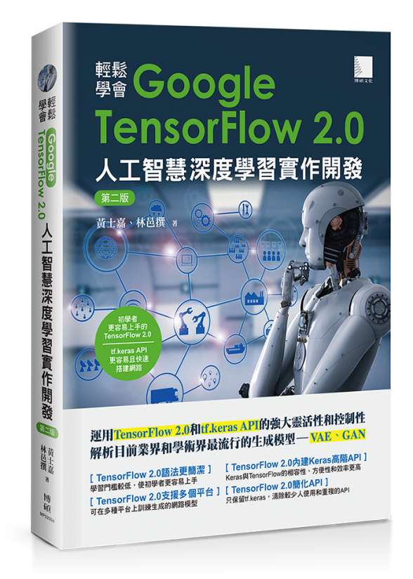
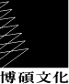
TensorFlow 2.0
謝坤達
課本：輕鬆學會Google TensorFlow 2.0人工智慧深度學習實作開發(第二版)
博碩文化出版發行

Slide 3
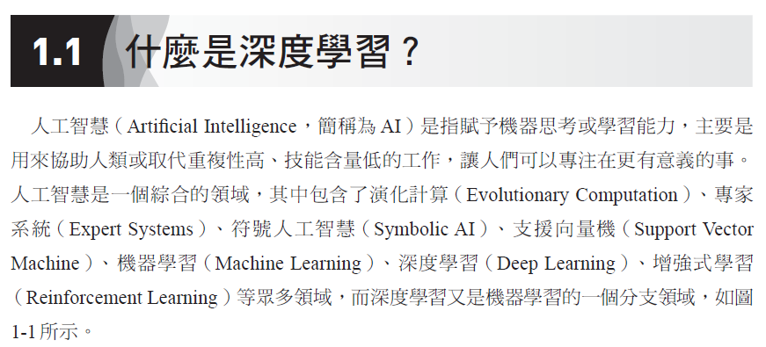
1.1 什麼是深度學習？

Slide 4
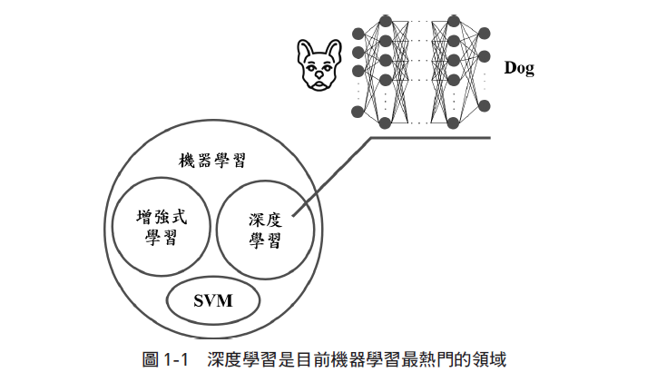
1.1 什麼是深度學習？

Slide 5
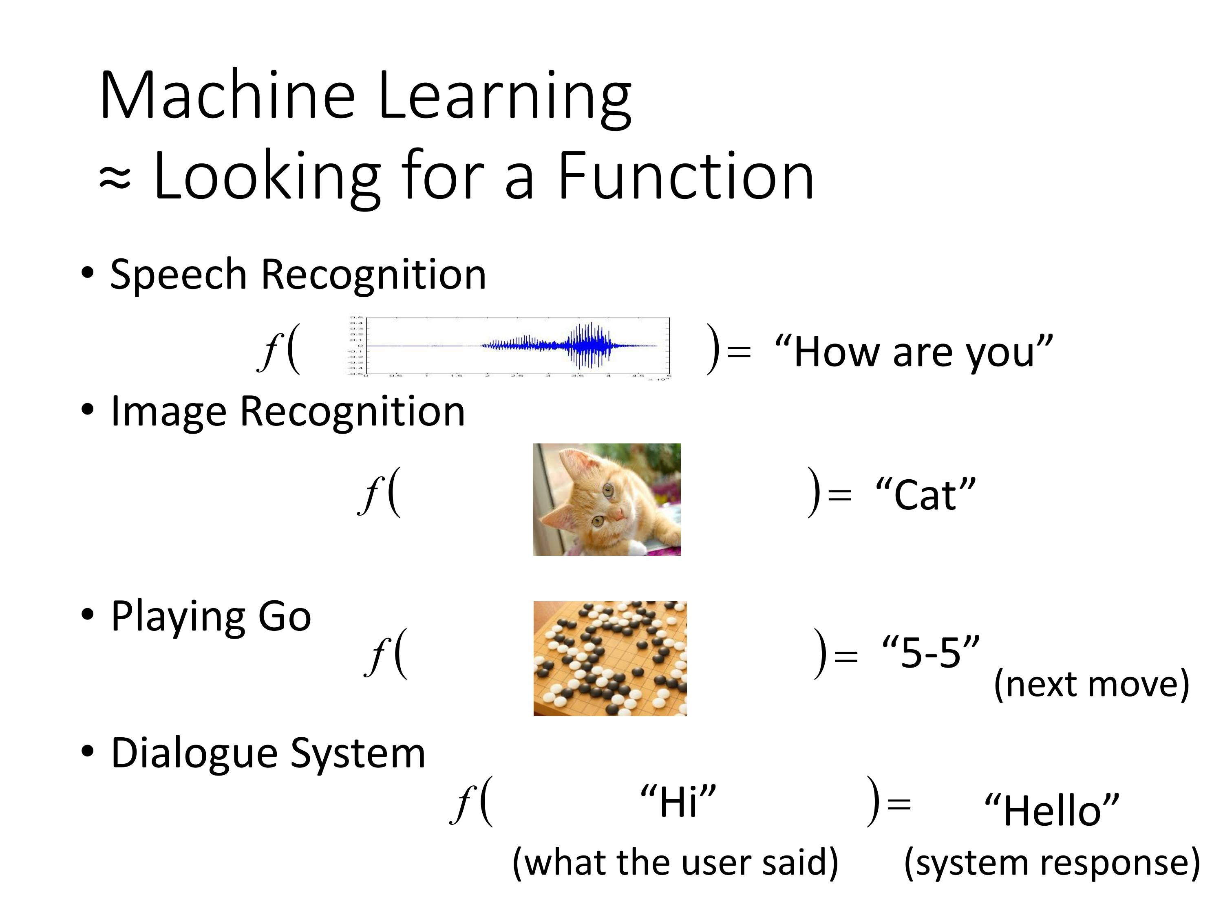

Slide 6
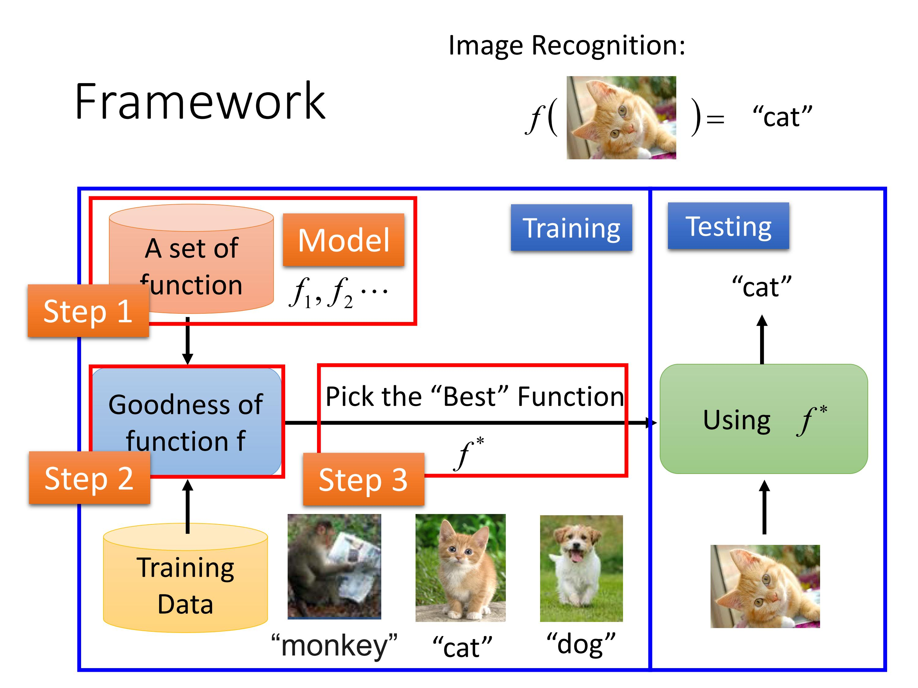

Slide 7
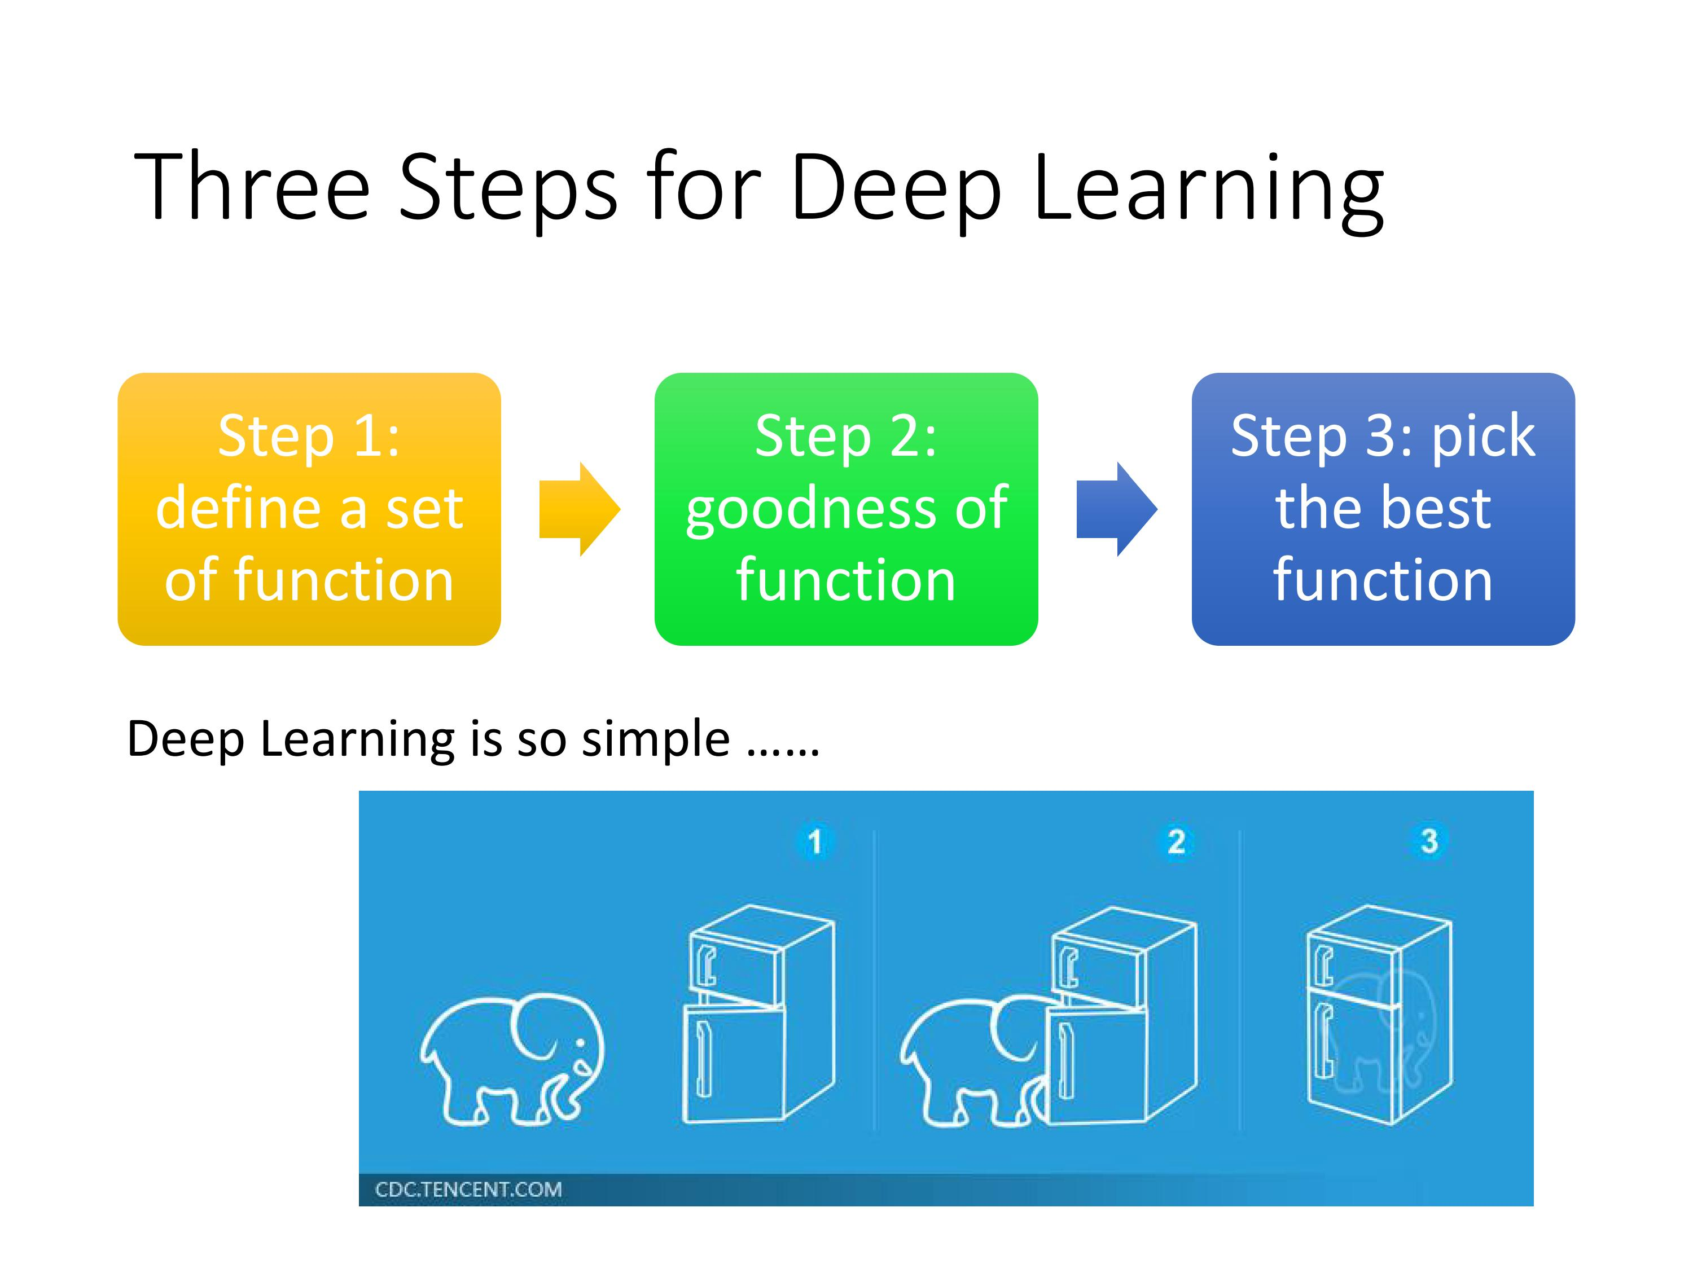

Slide 8
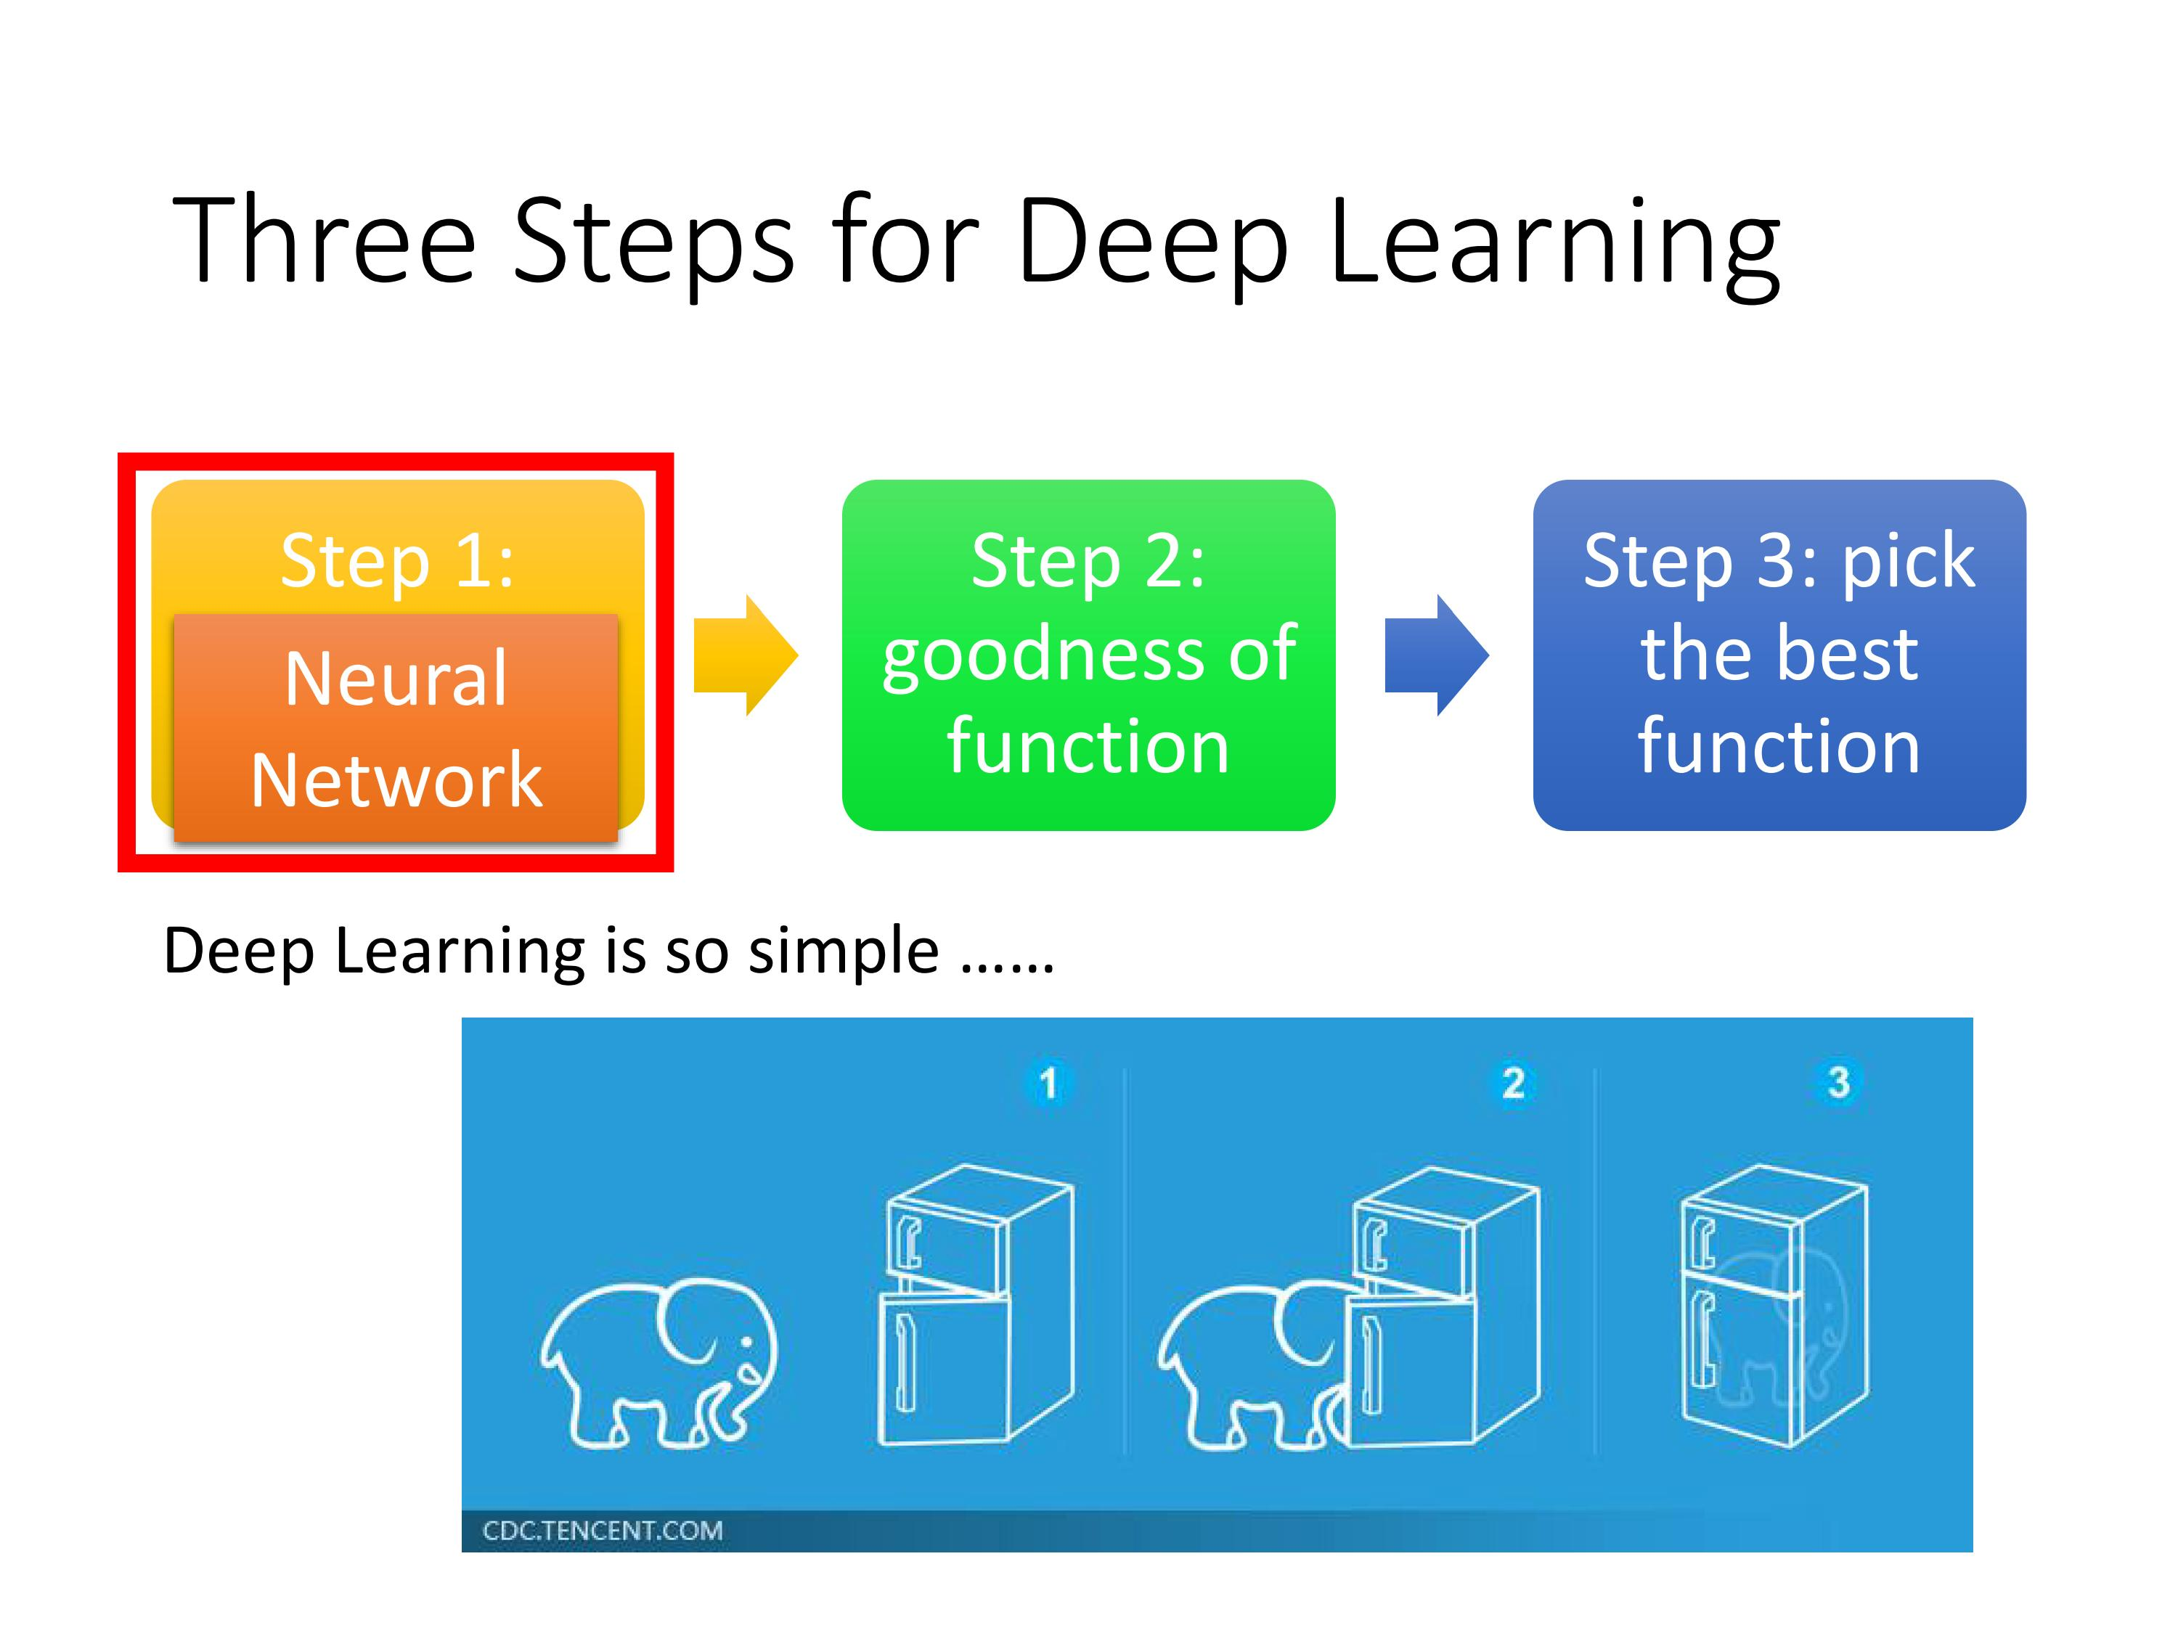

Slide 9
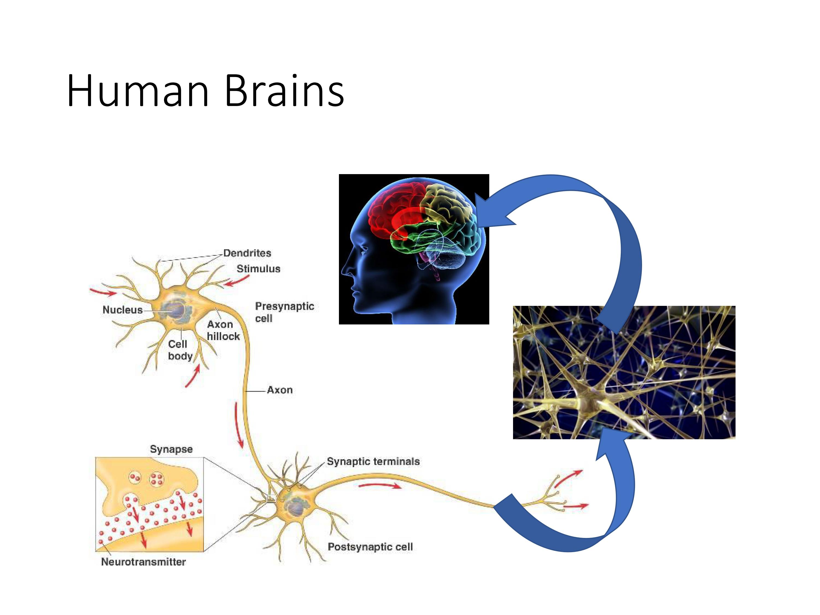

Slide 10
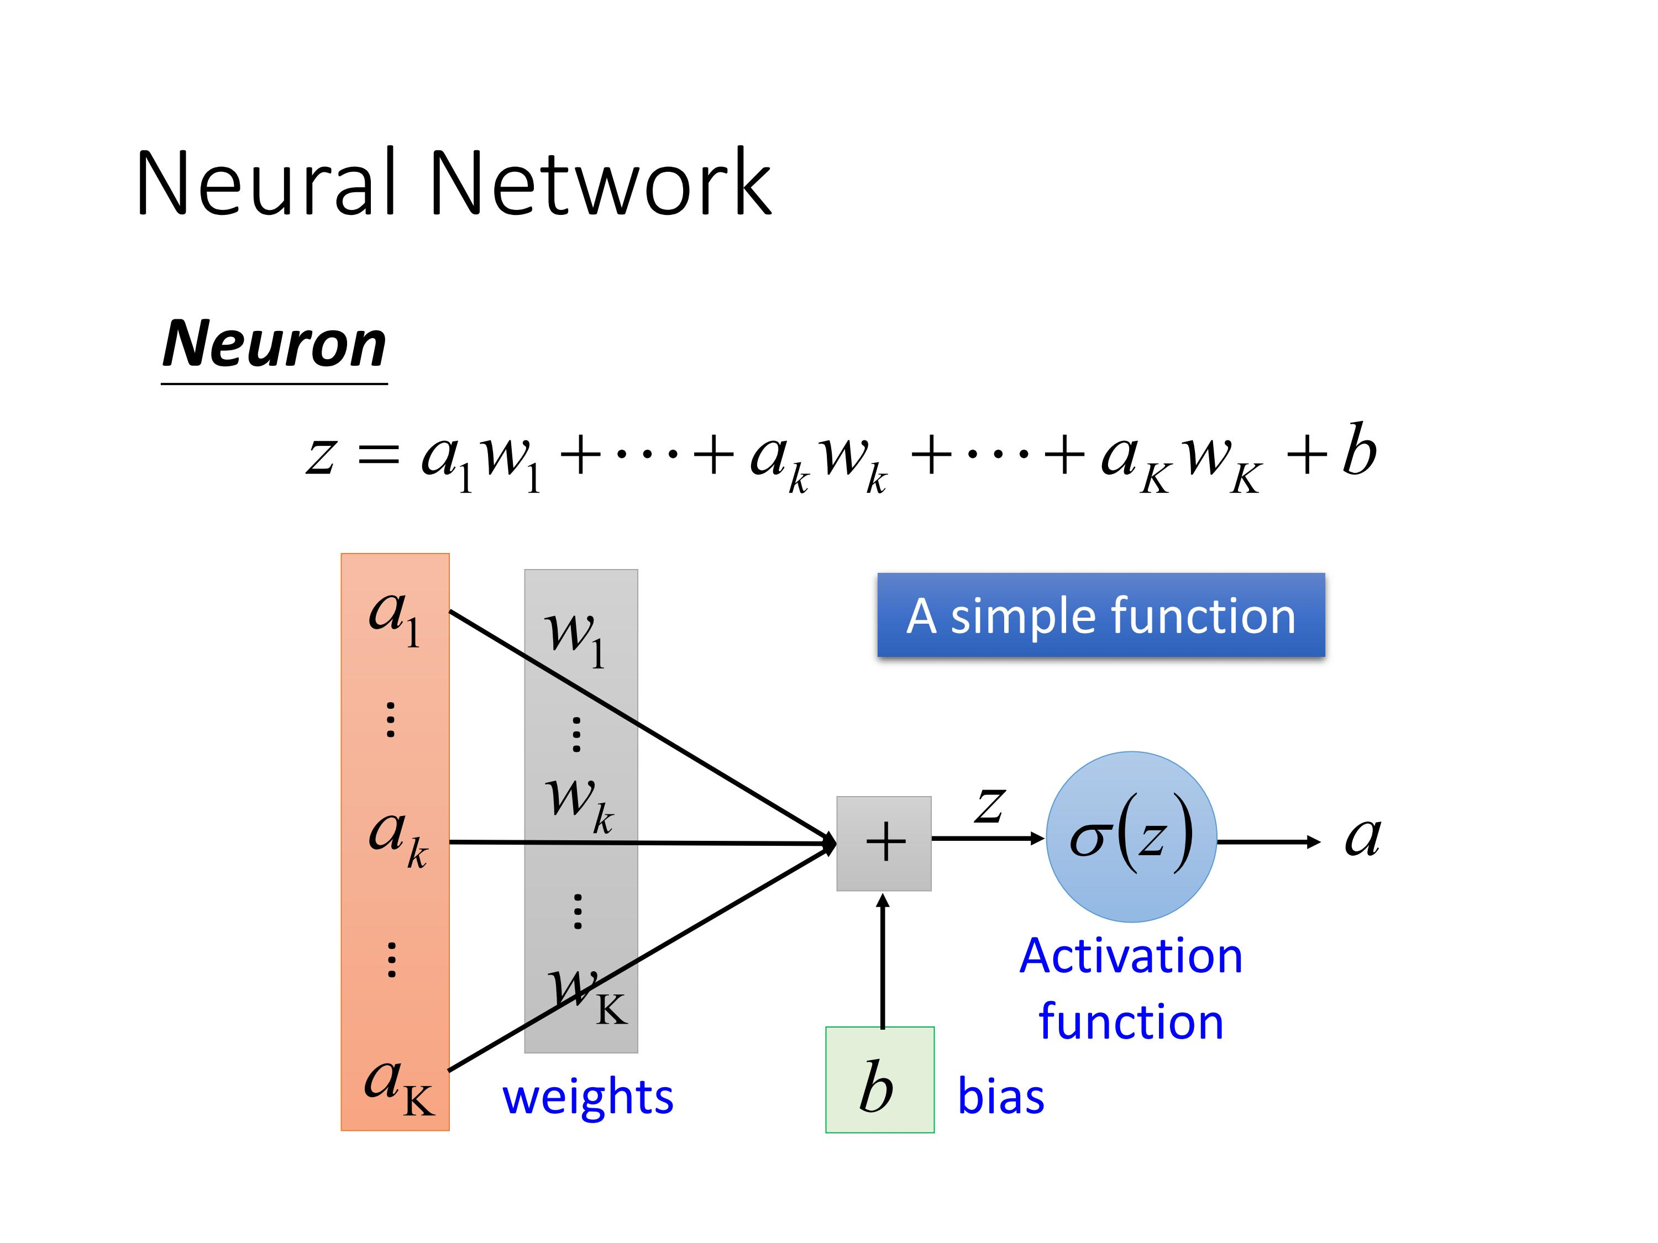

Slide 11
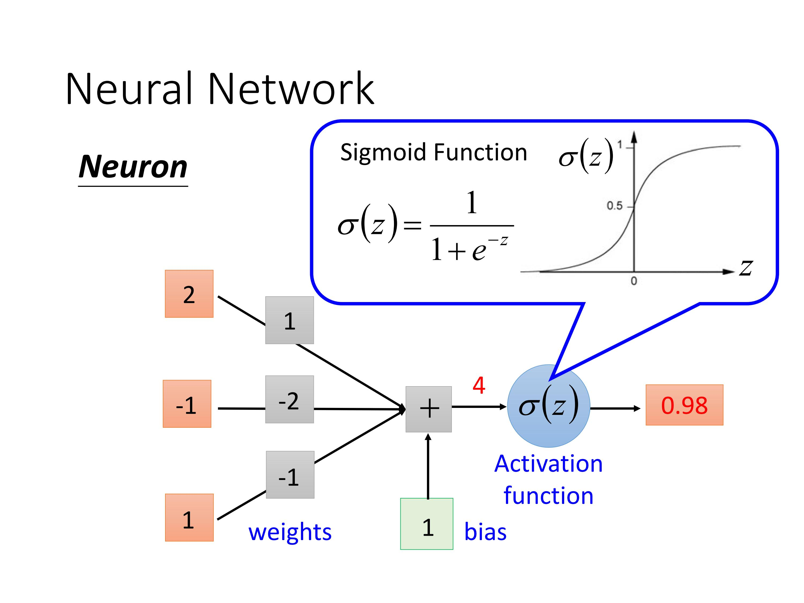

Slide 12
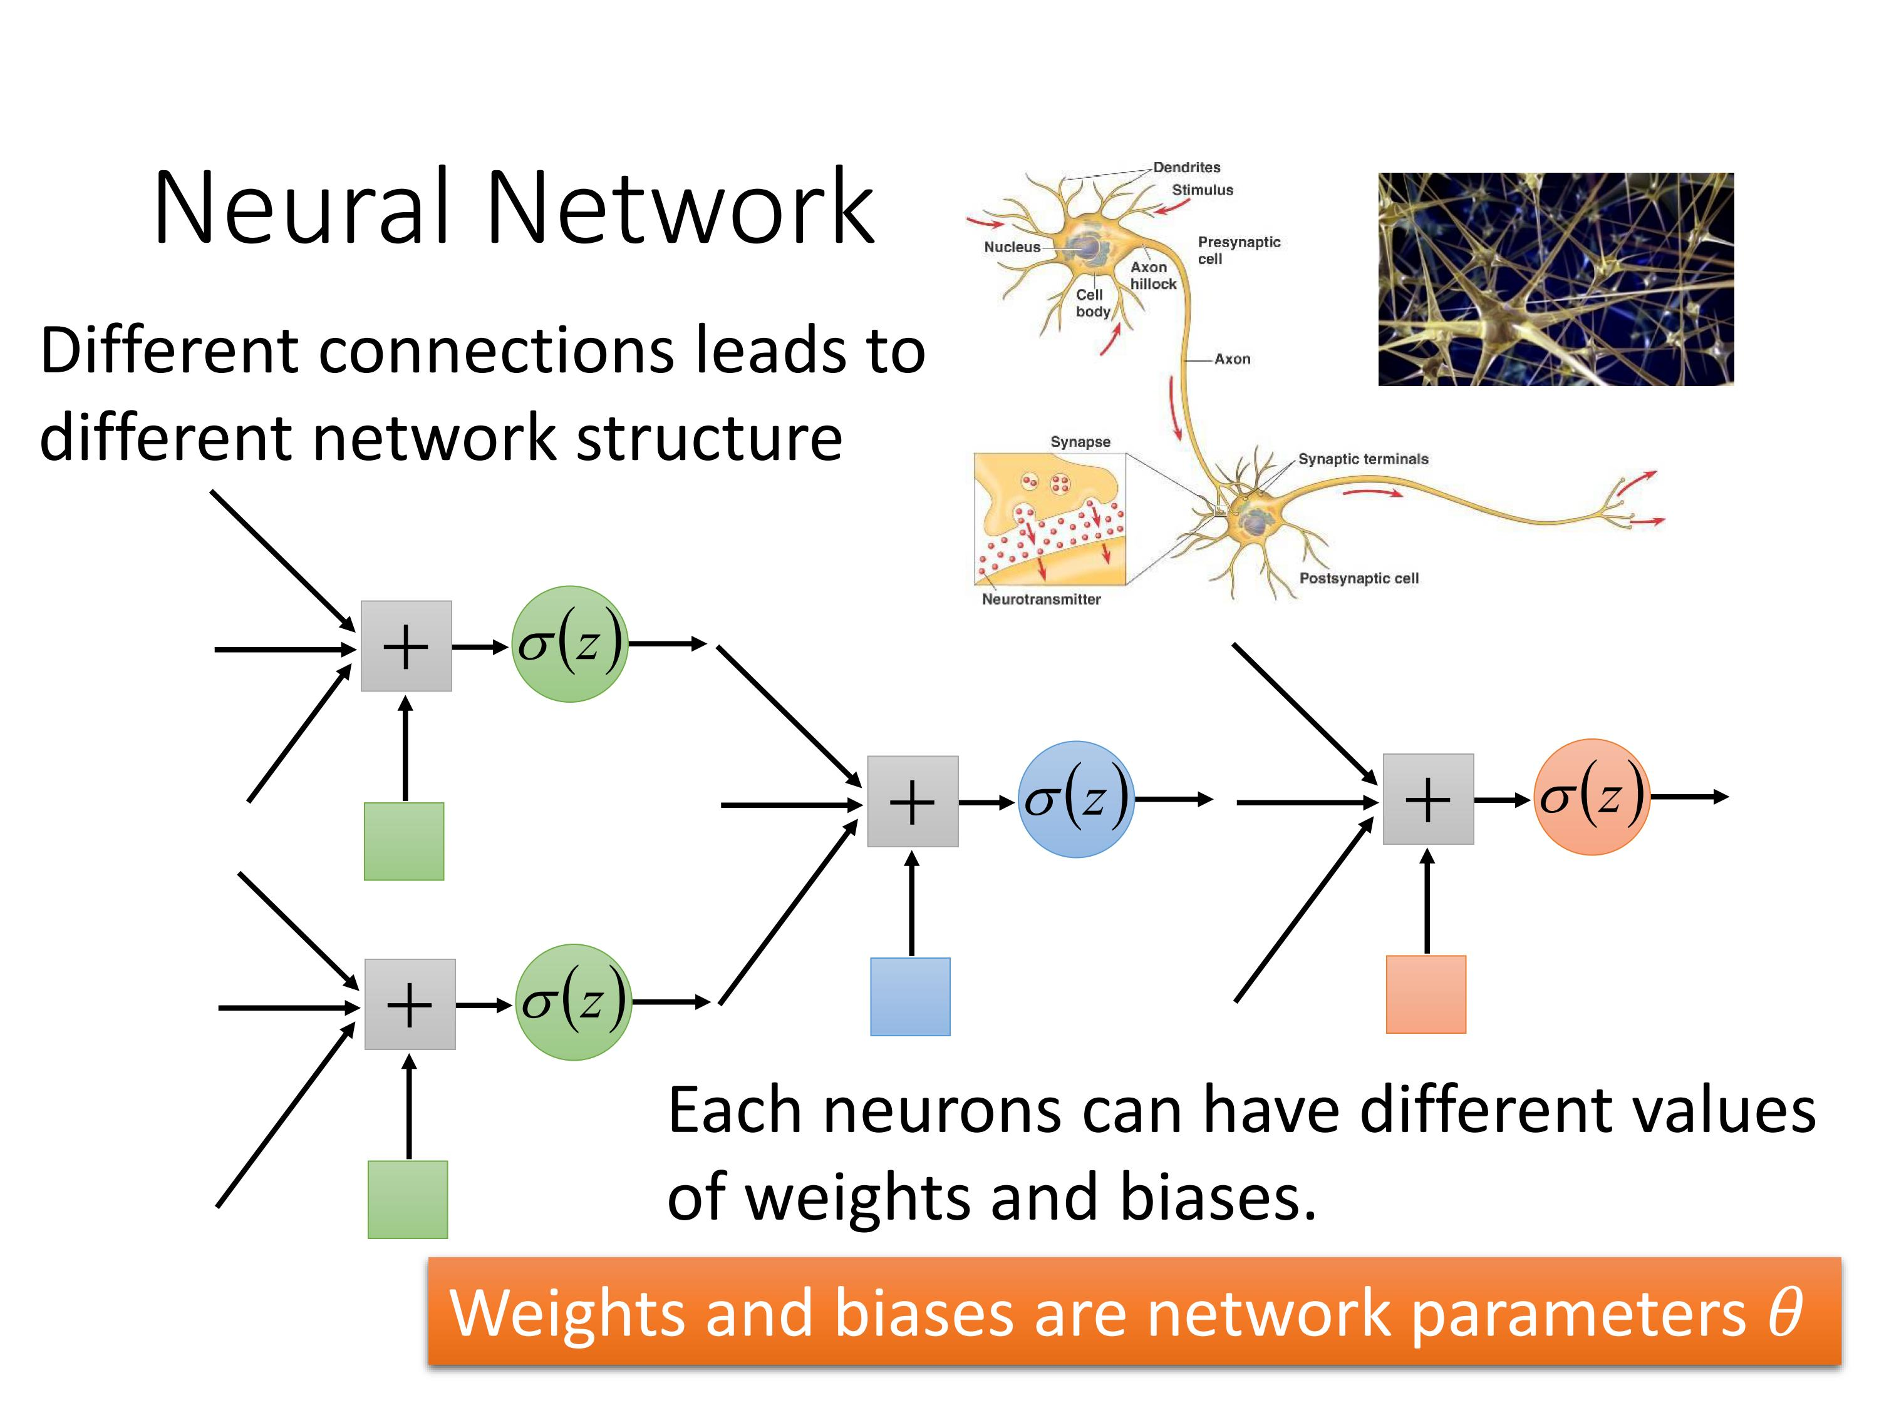

Slide 13
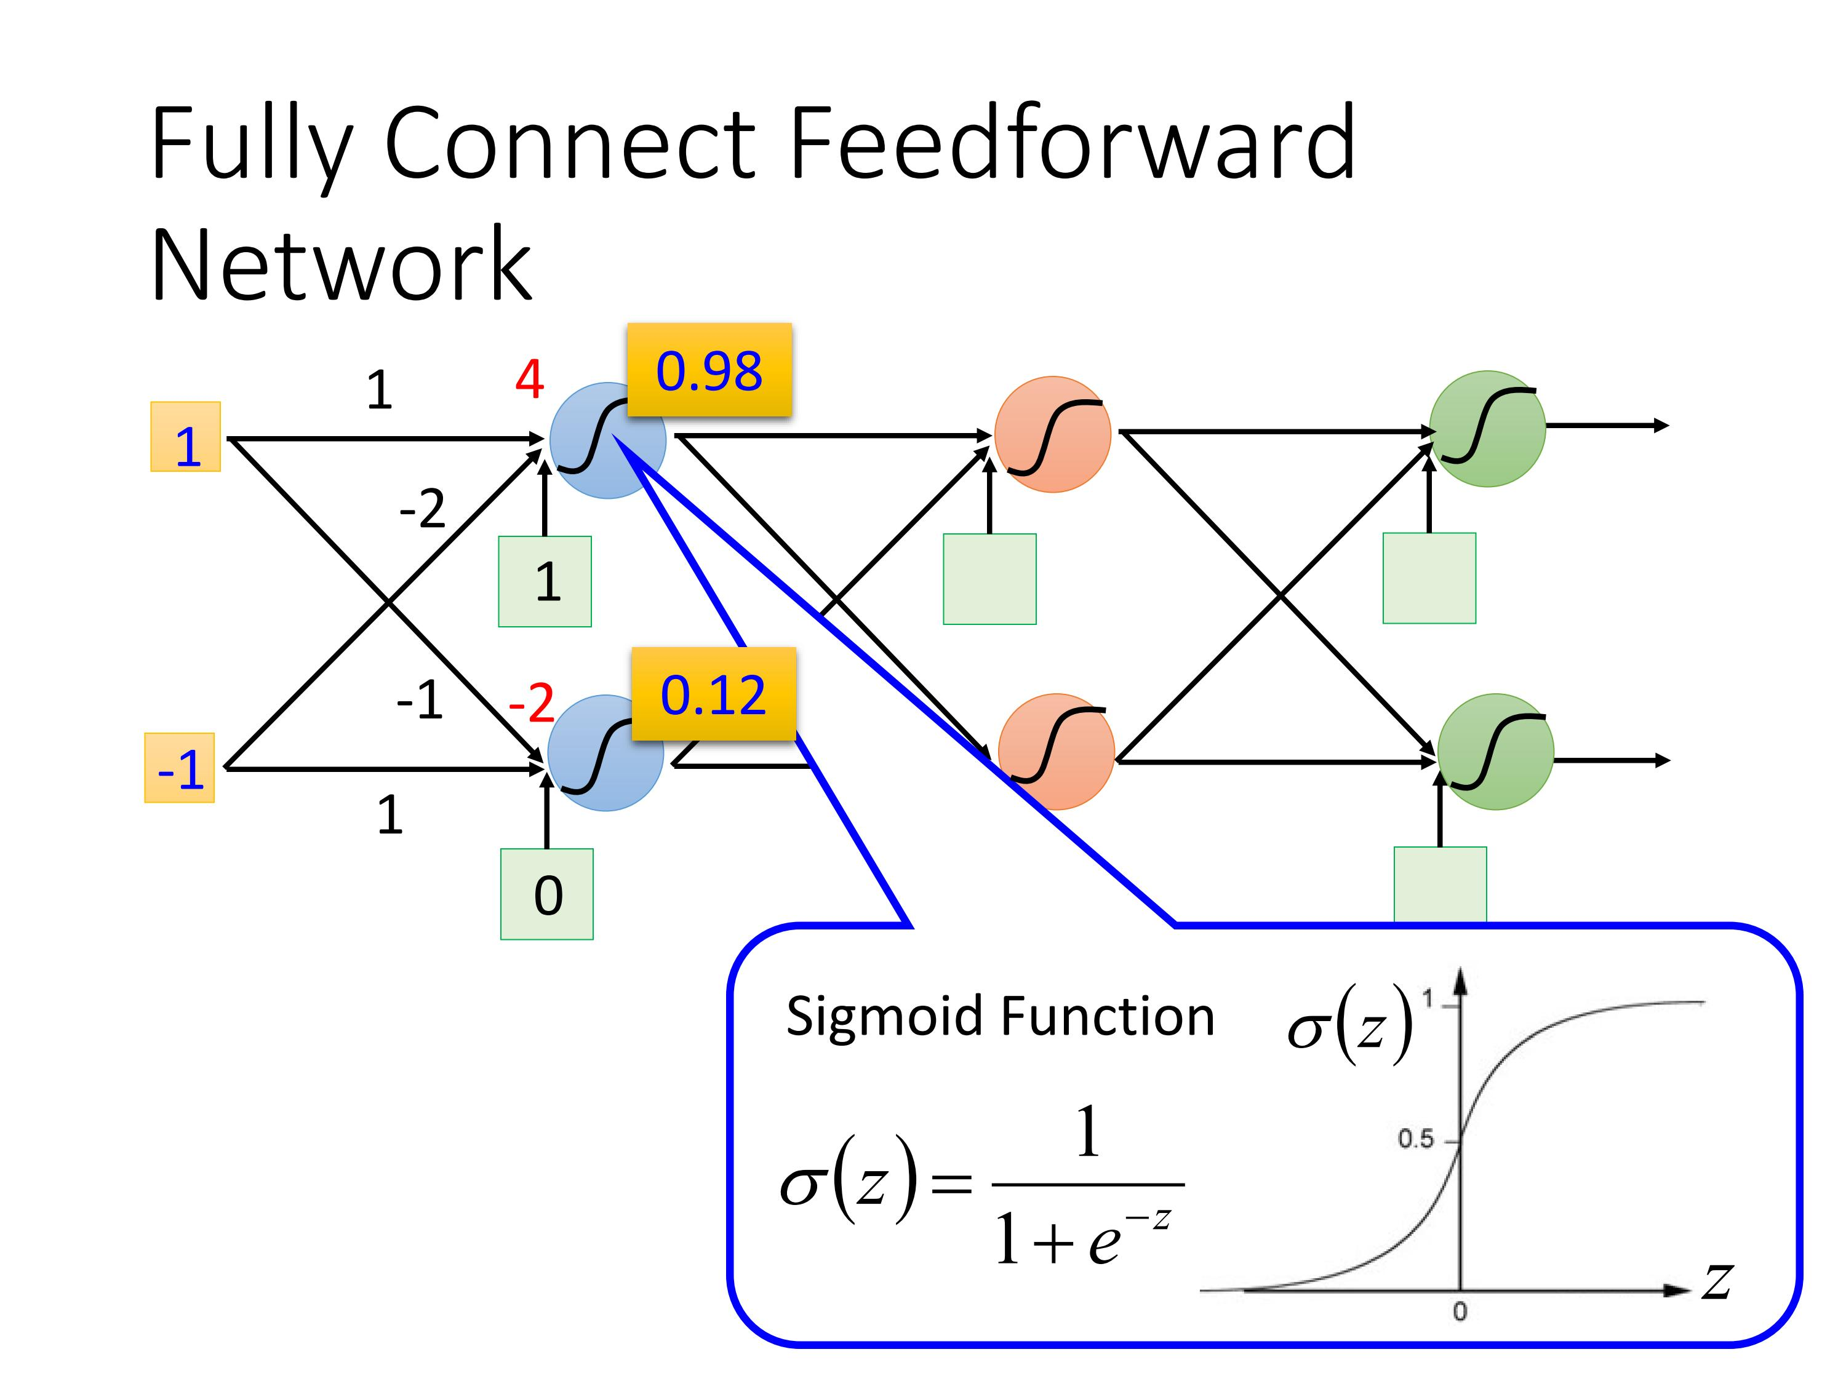

Slide 14
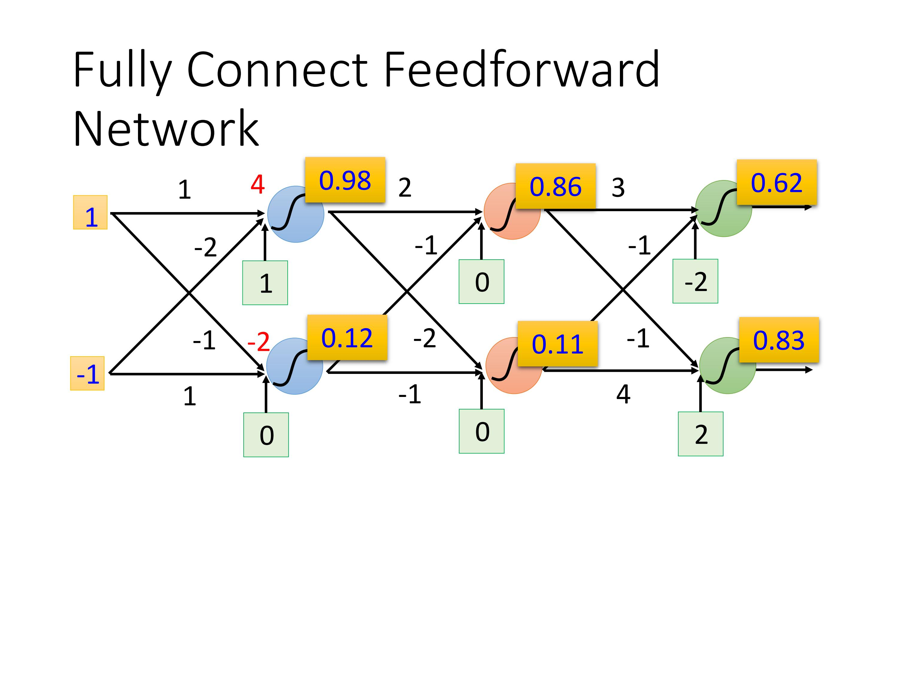

Slide 15
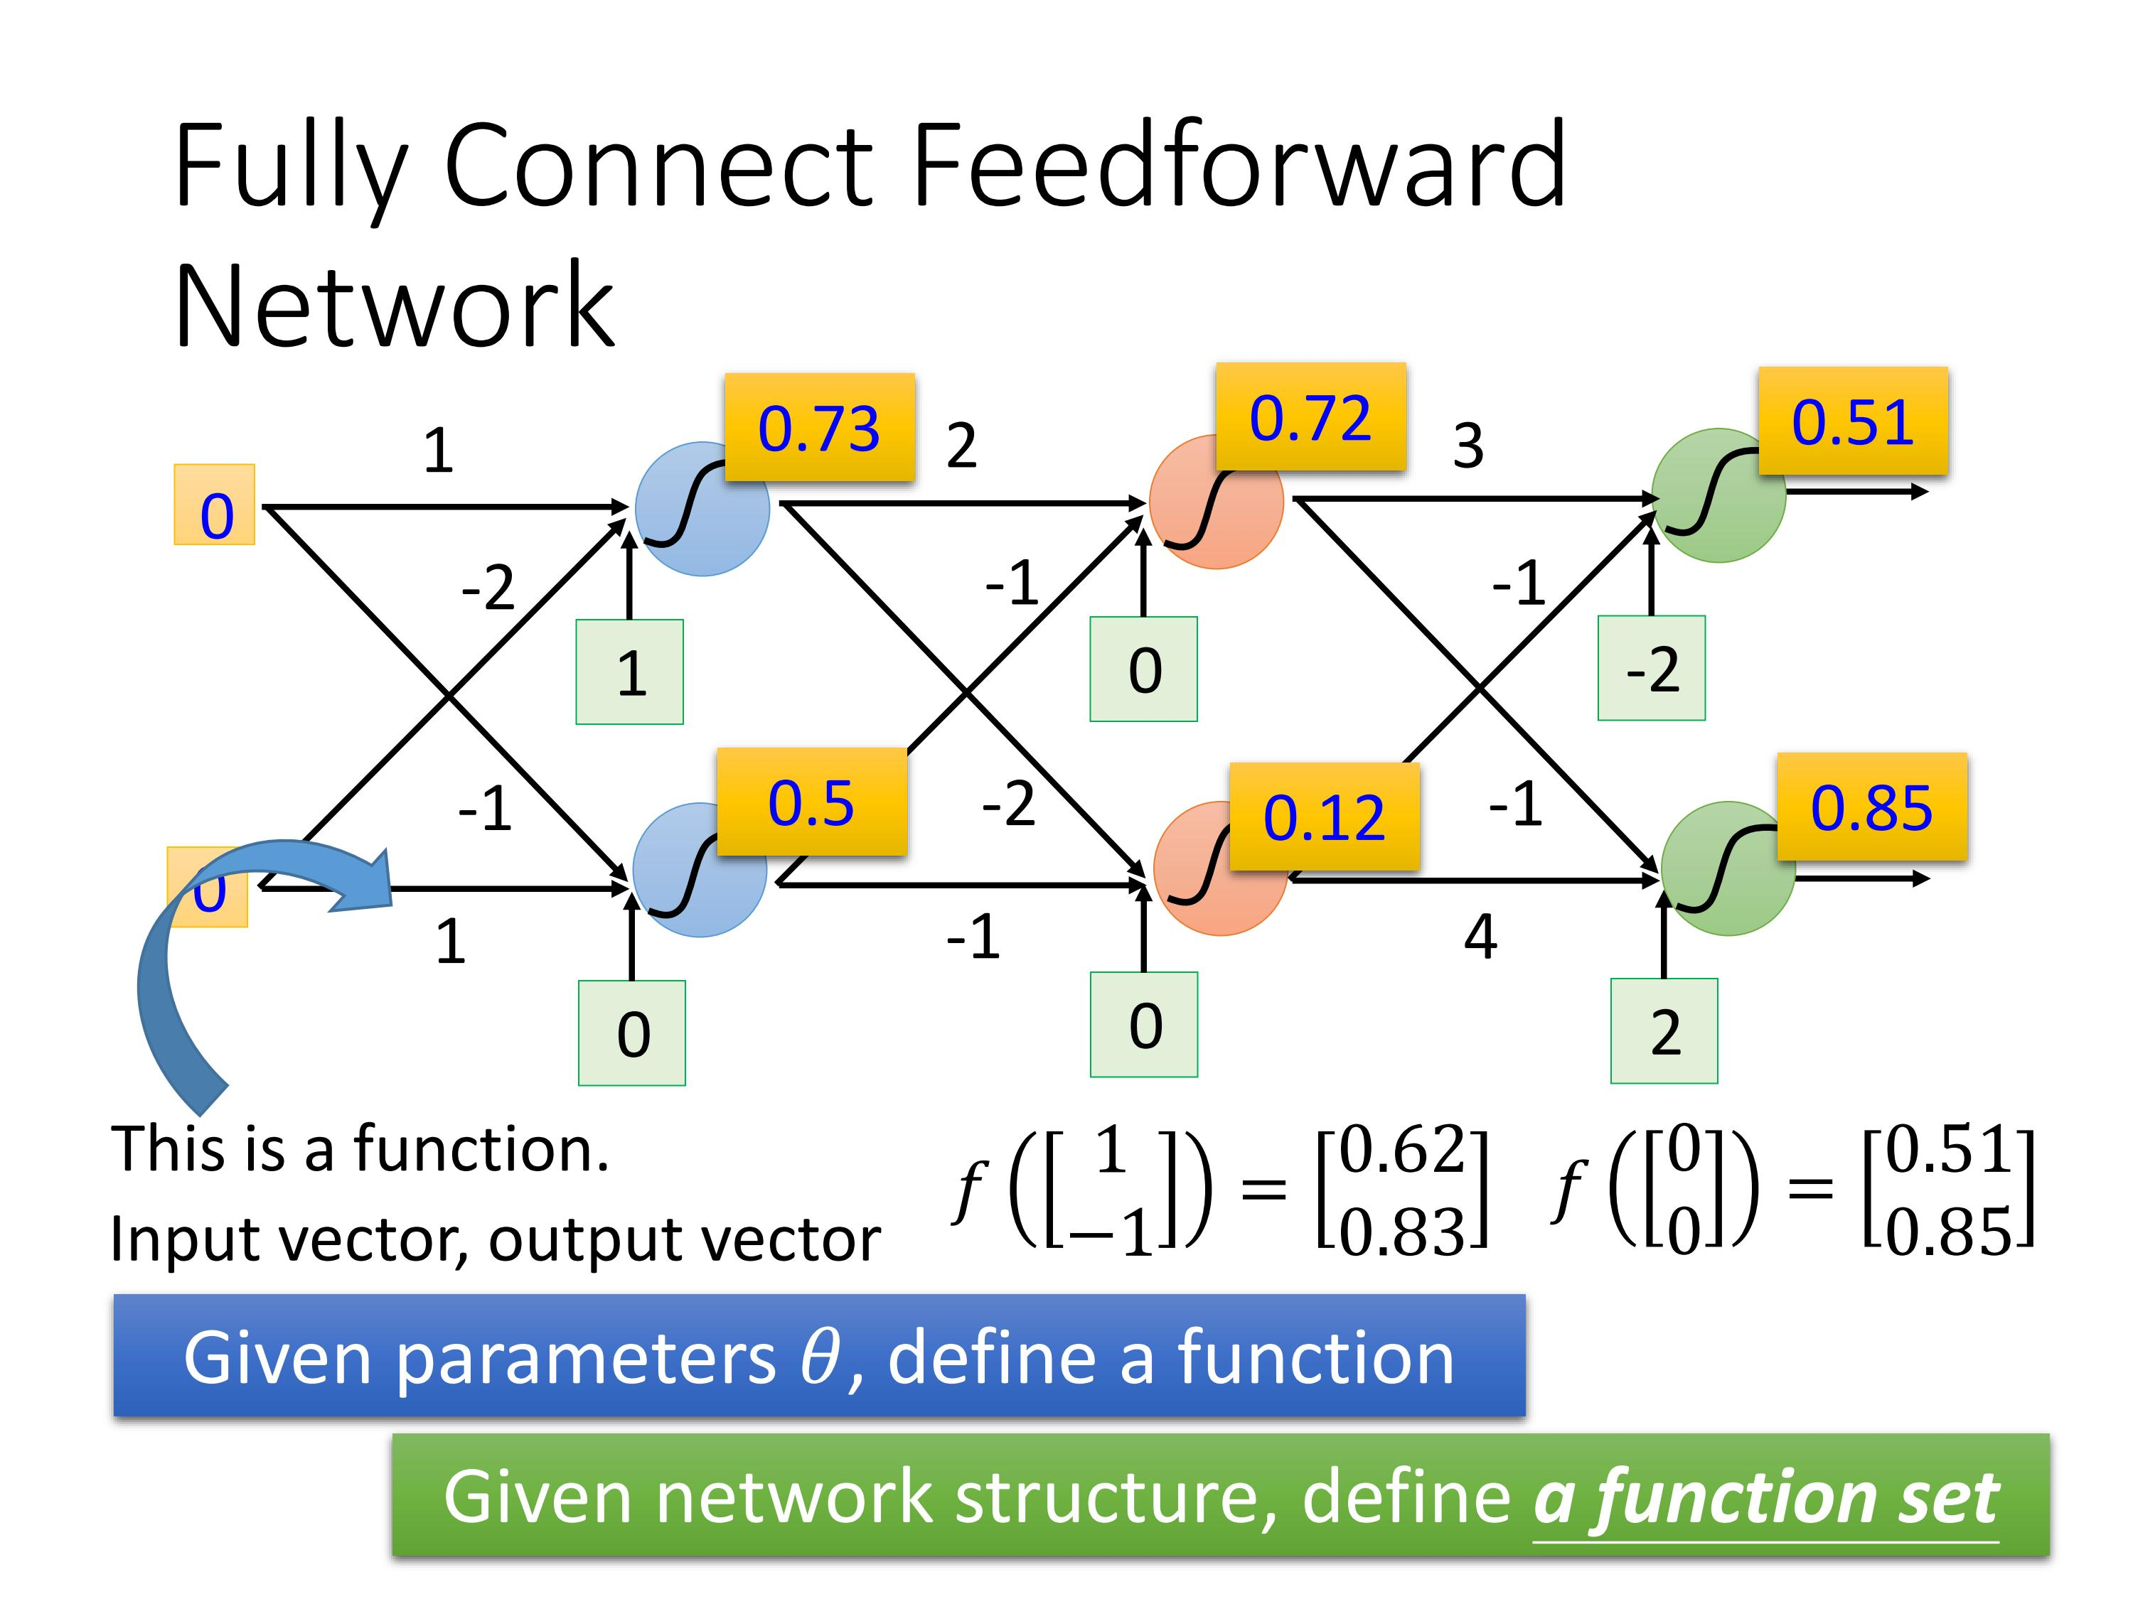

Slide 16
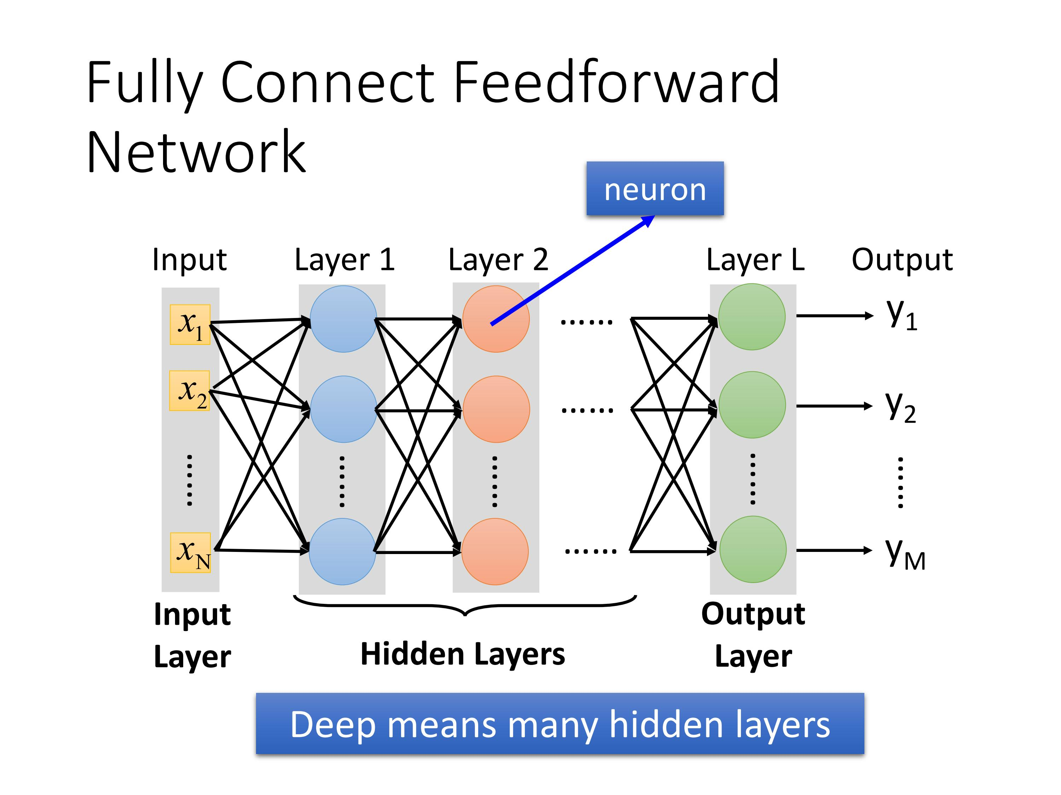

Slide 17
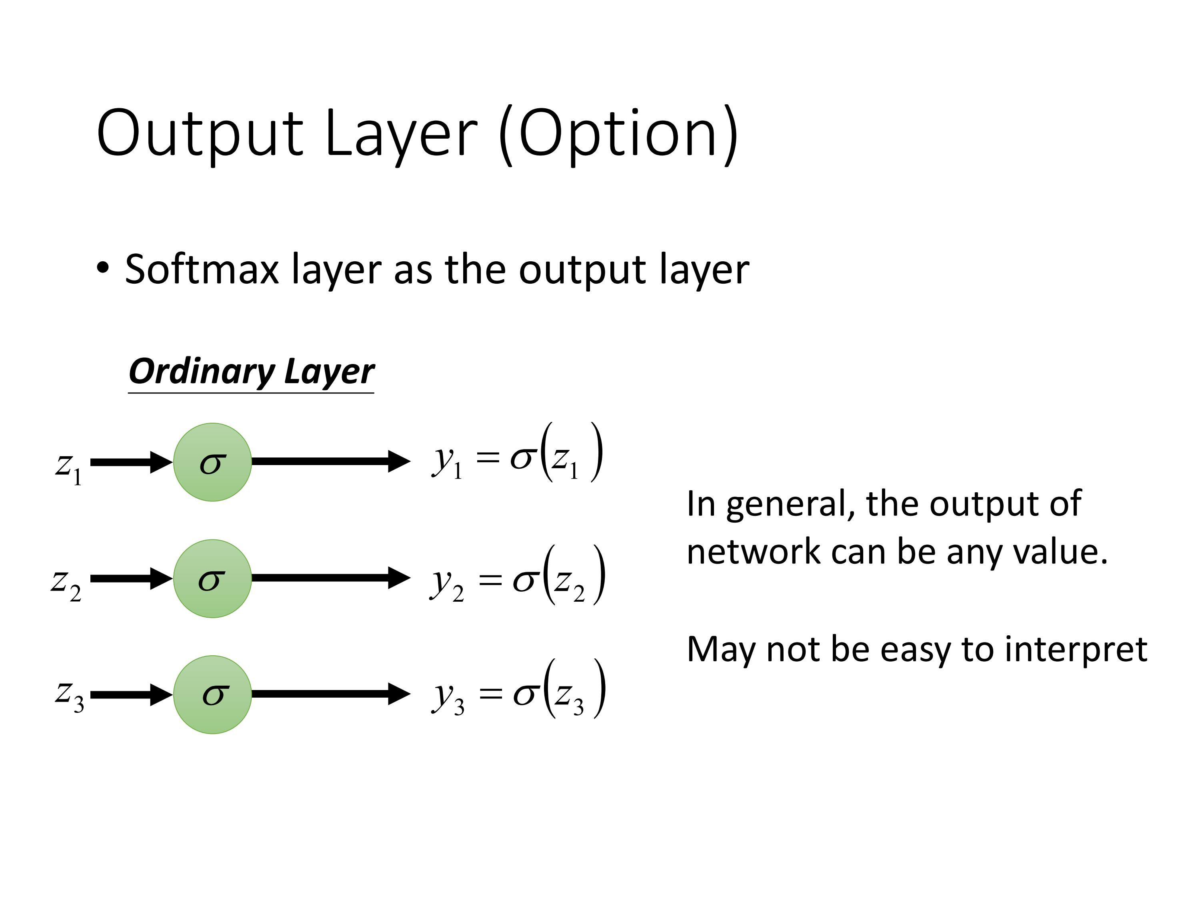

Slide 18
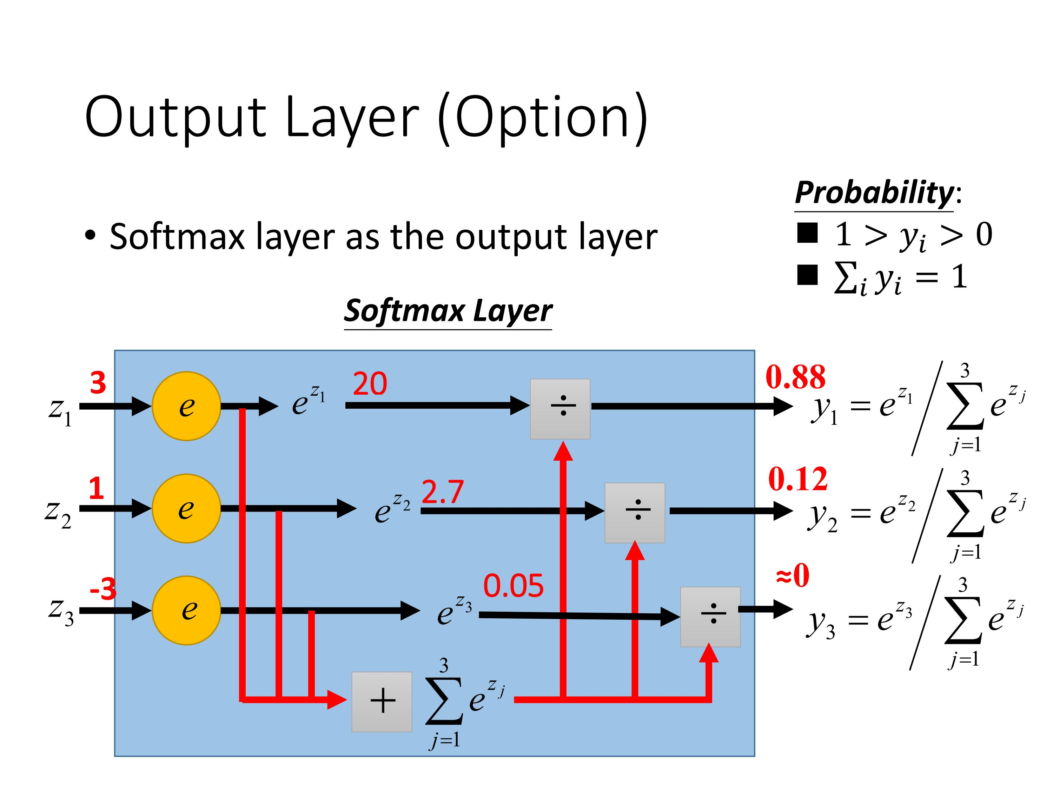

Slide 19
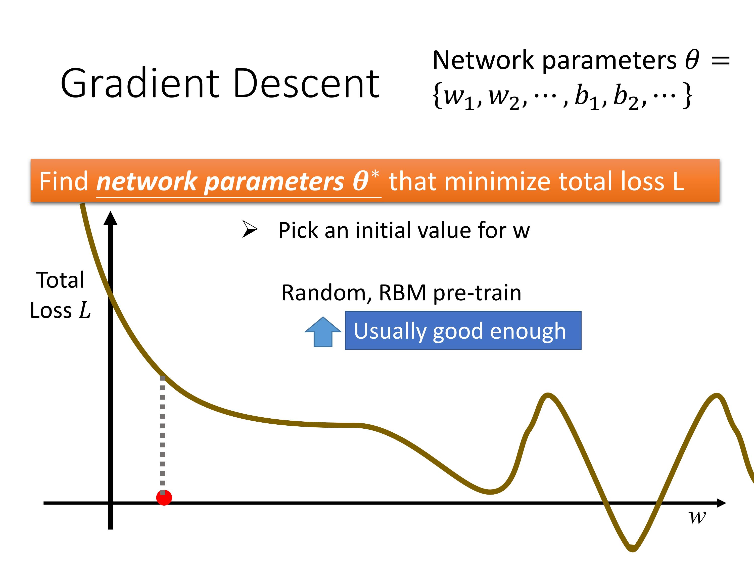

Slide 20
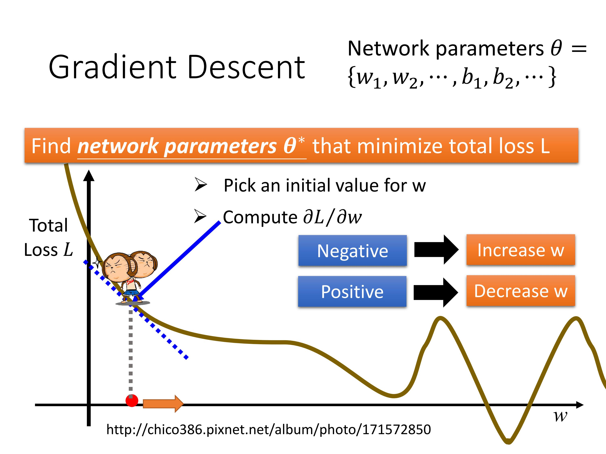

Slide 21
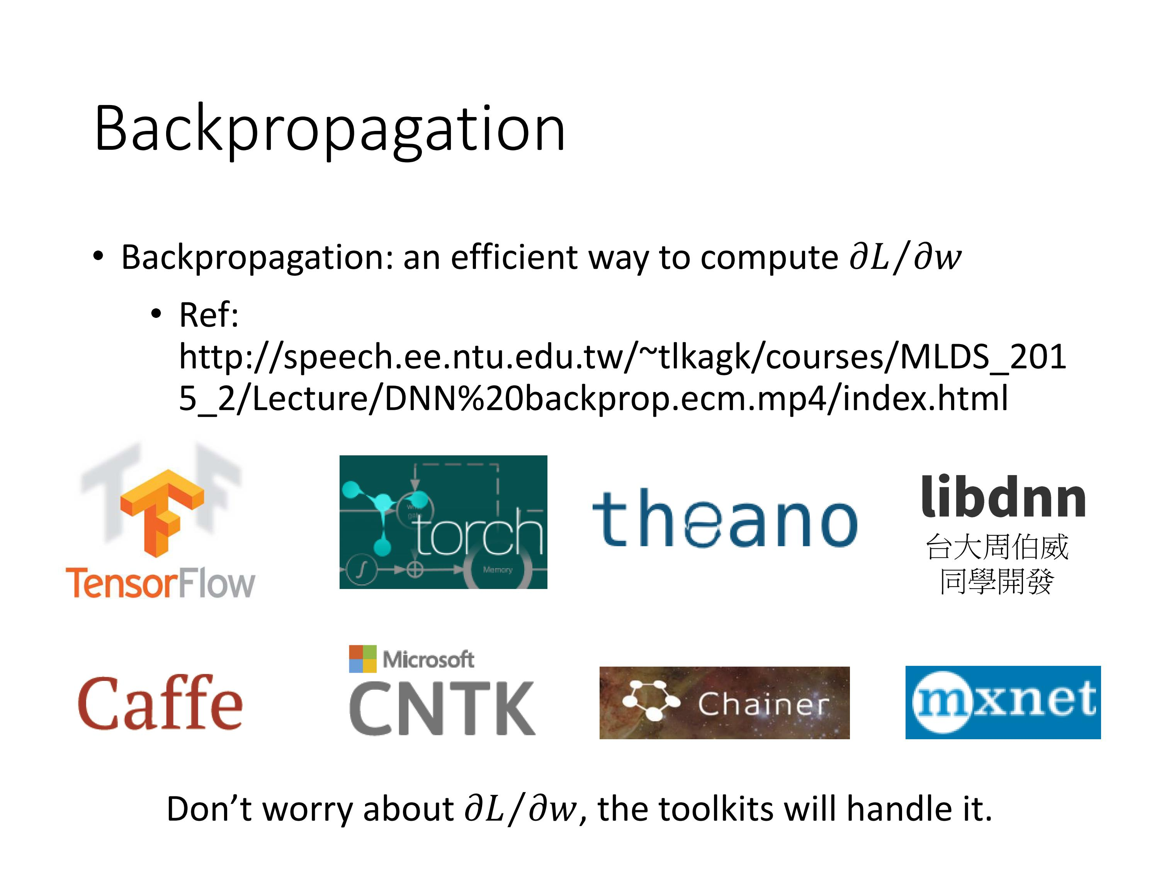

Slide 22
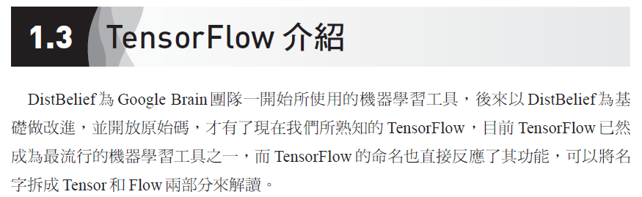
1.3 TensorFlow 介紹

Slide 23
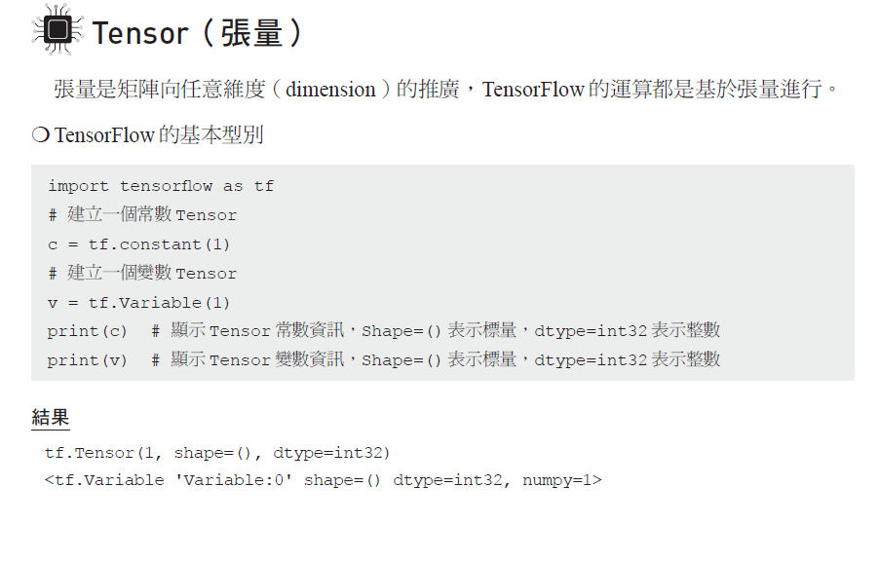
1.3 TensorFlow 介紹

Slide 24
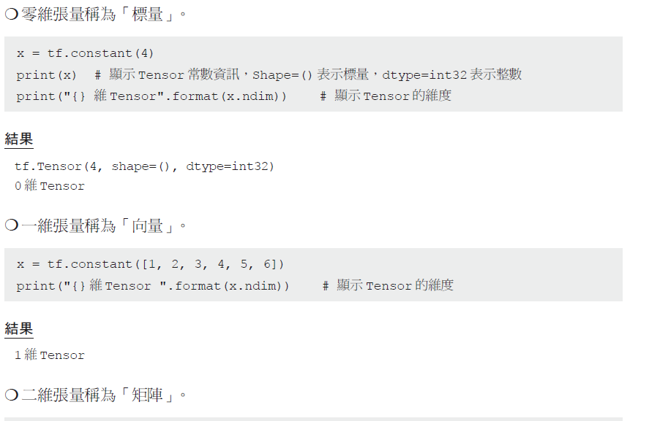
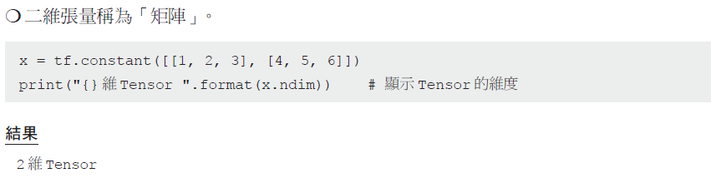
1.3 TensorFlow 介紹

Slide 25
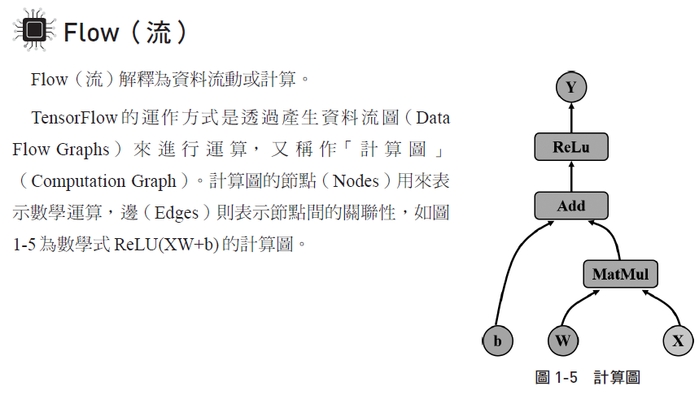
1.3 TensorFlow 介紹

Slide 26
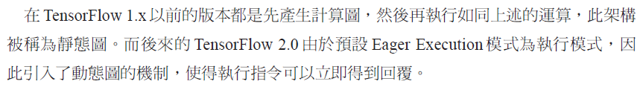
1.3 TensorFlow 介紹

Slide 27
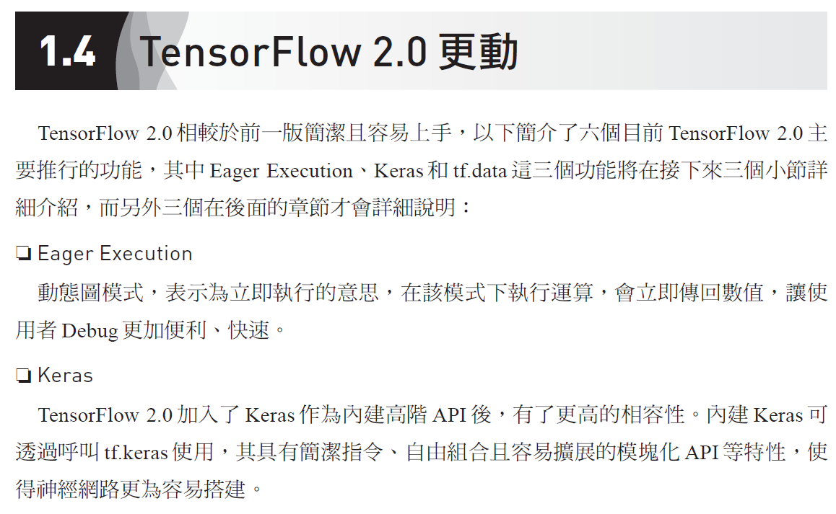
1.4 TensorFlow 2.0 更動

Slide 28
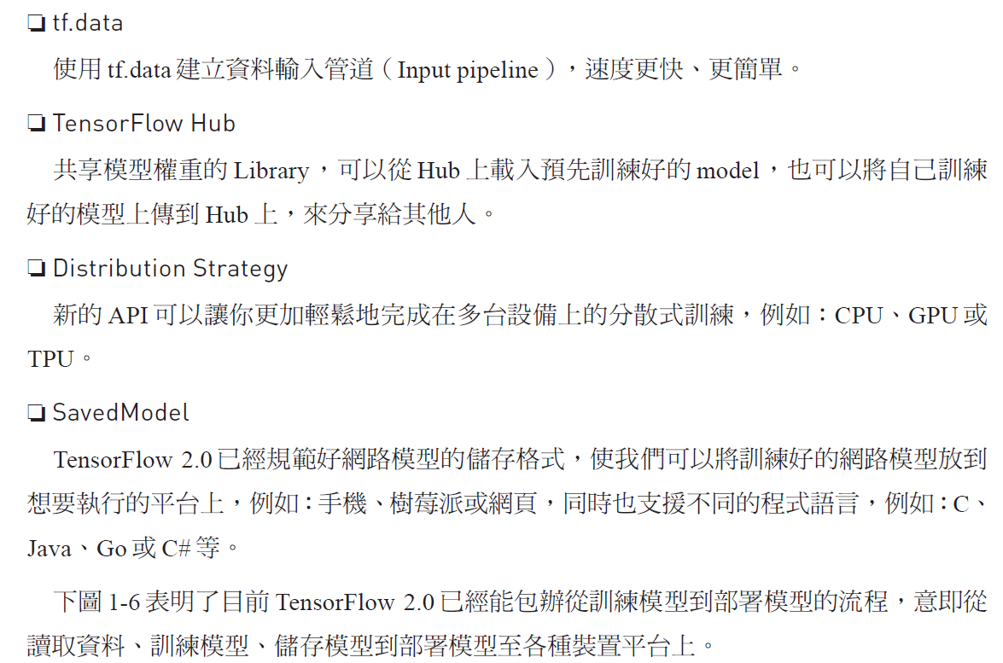
1.4 TensorFlow 2.0 更動

Slide 29
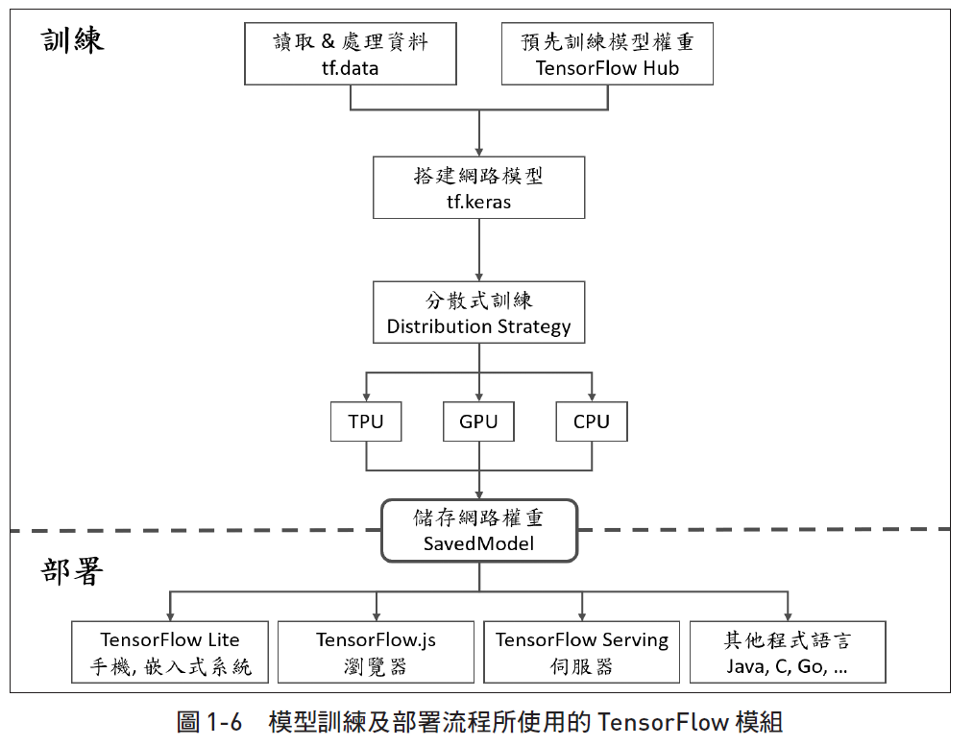
1.4 TensorFlow 2.0 更動

Slide 30
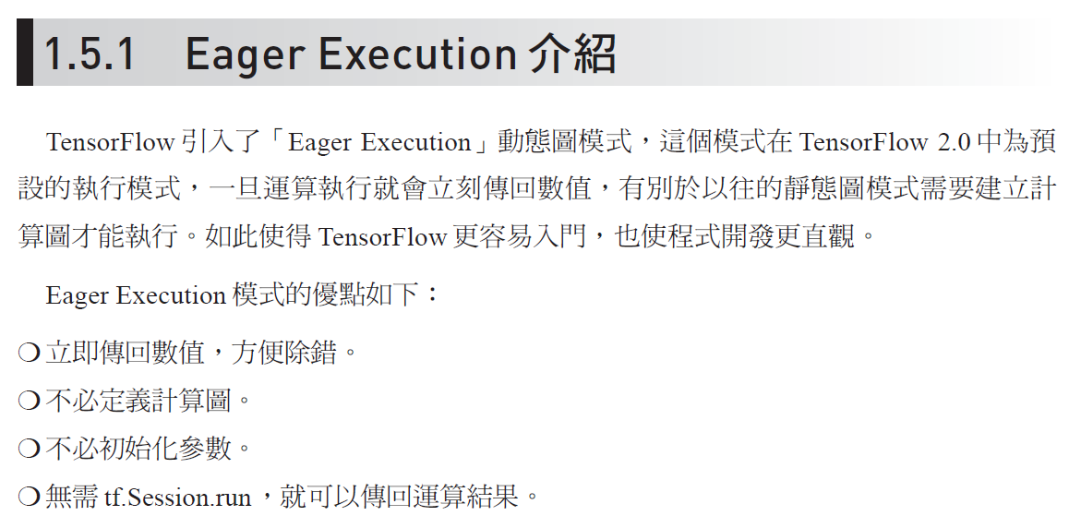
1.5 Eager Execution

Slide 31
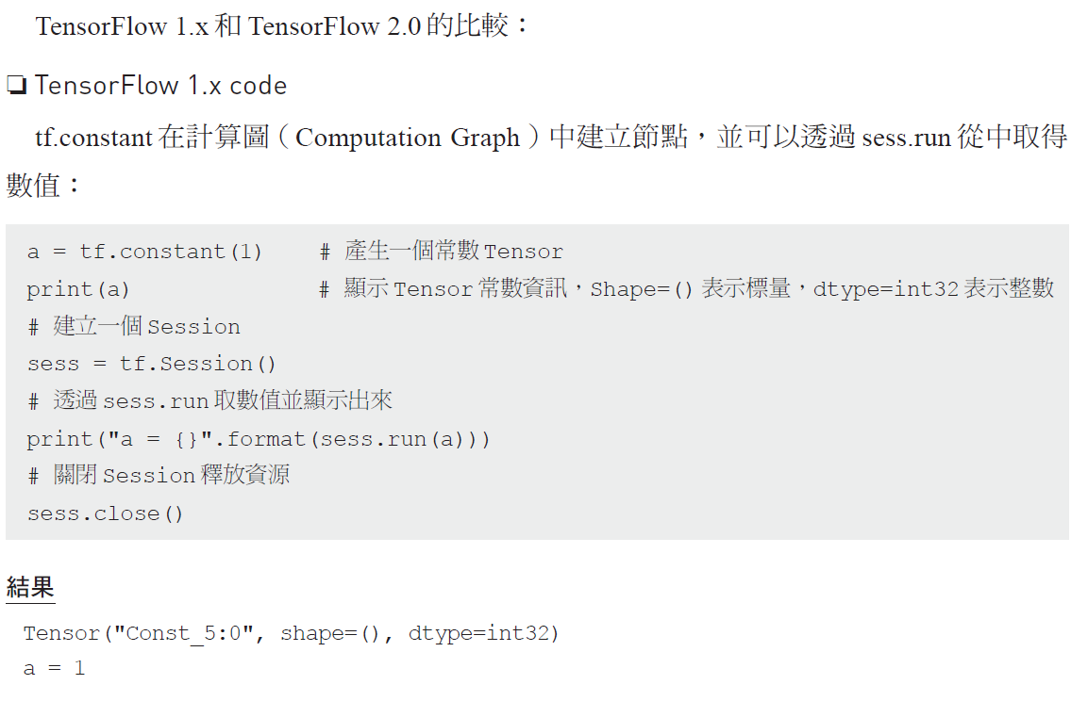
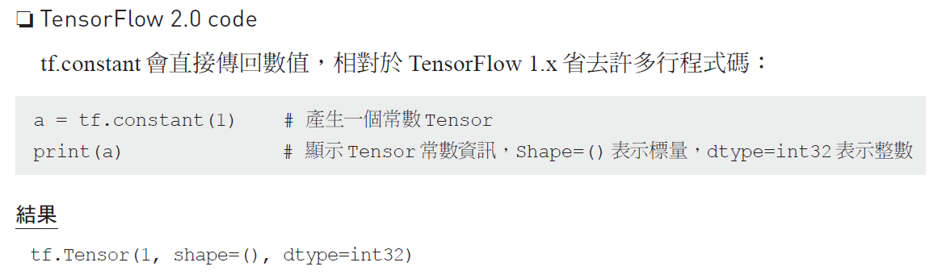
1.5 Eager Execution

Slide 32
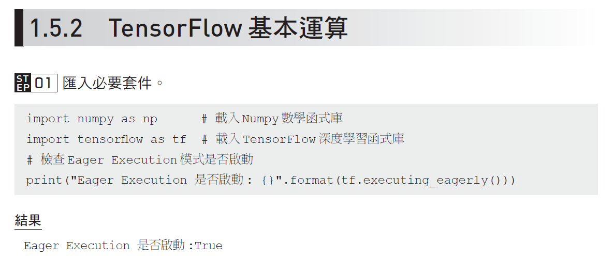
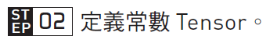
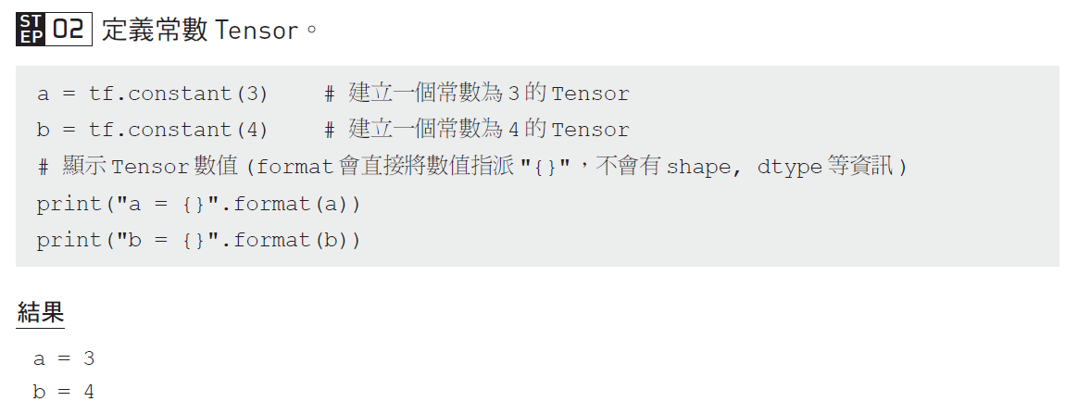
1.5 Eager Execution

Slide 33
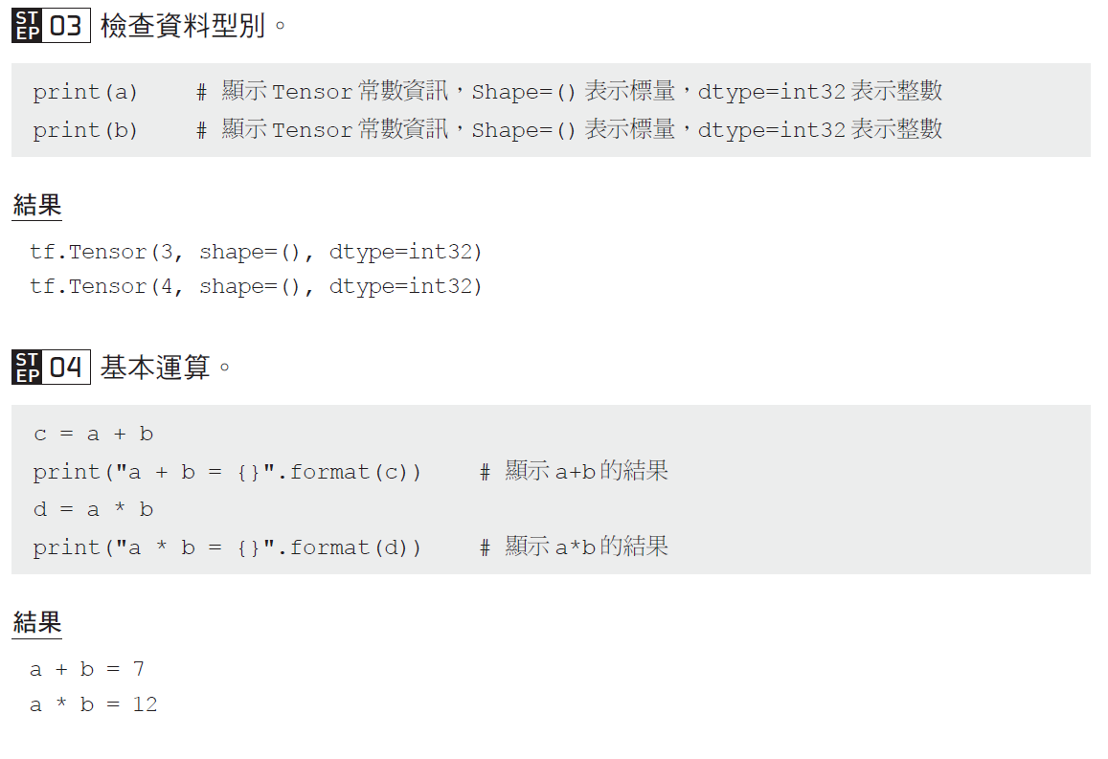
1.5 Eager Execution

Slide 34
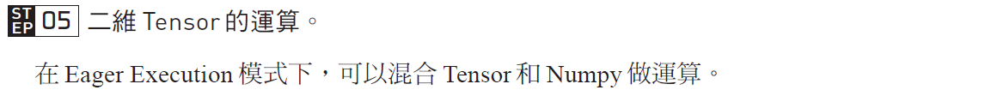
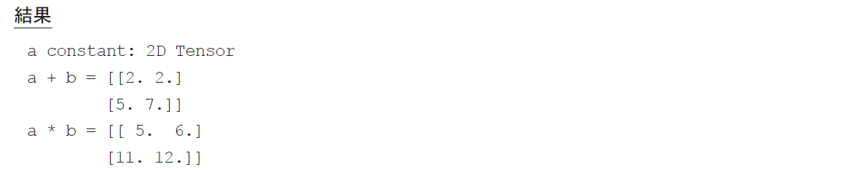
1.5 Eager Execution

Slide 35
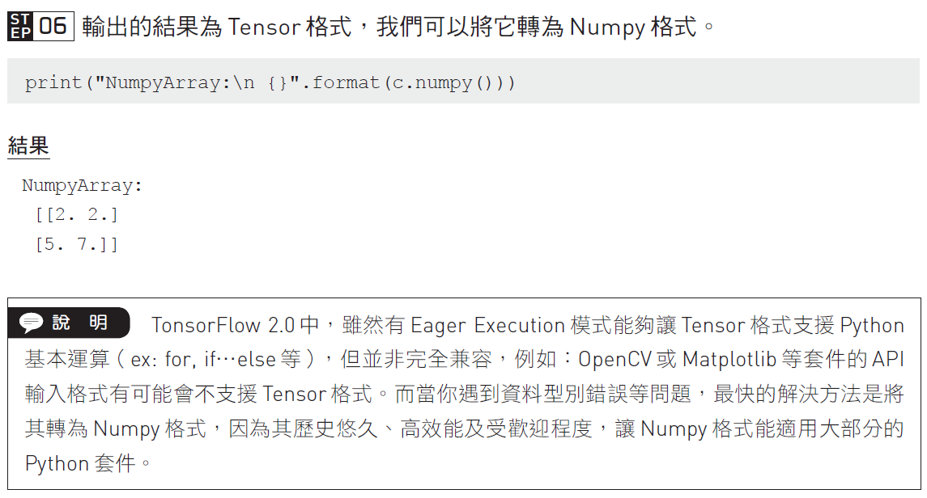
1.5 Eager Execution

Slide 36
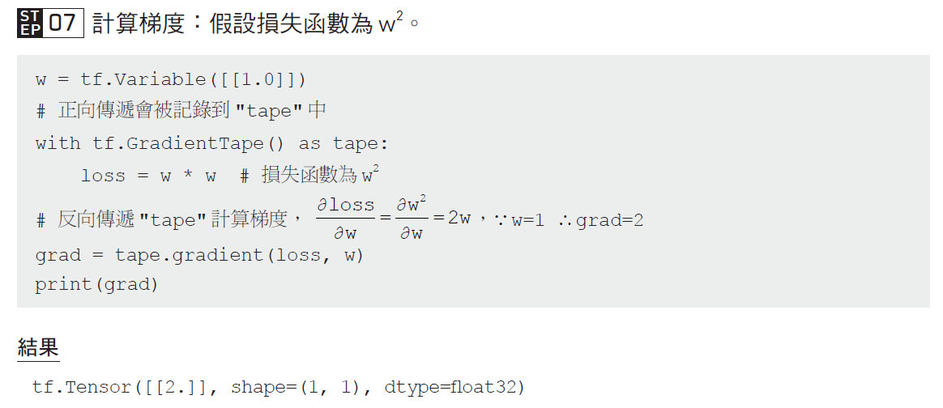
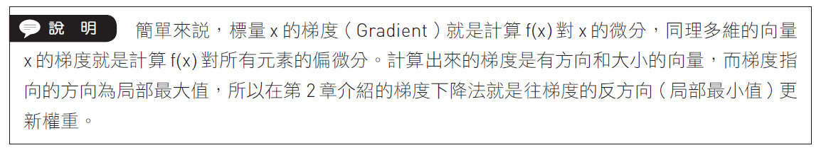
1.5 Eager Execution

Slide 37
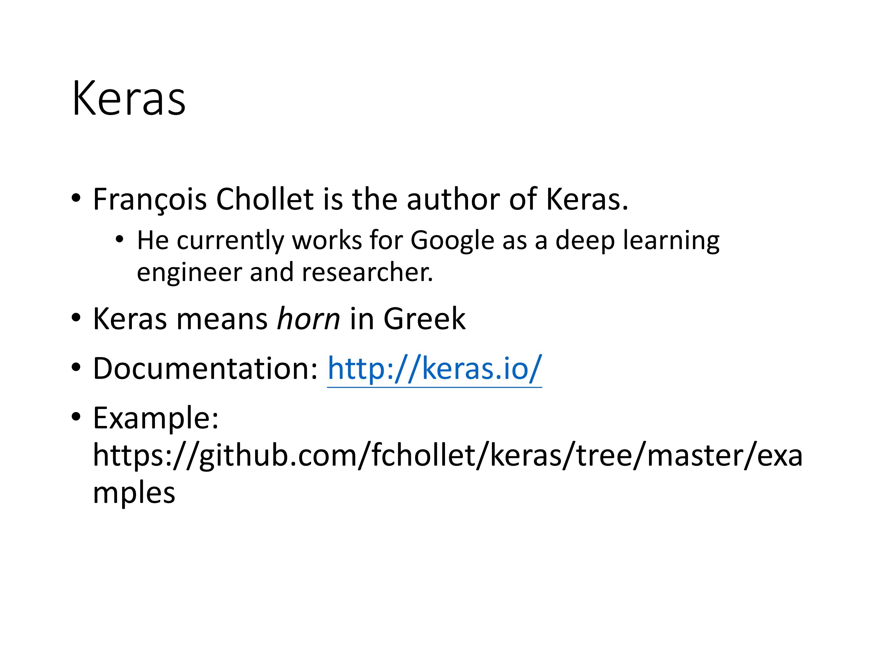

Slide 38
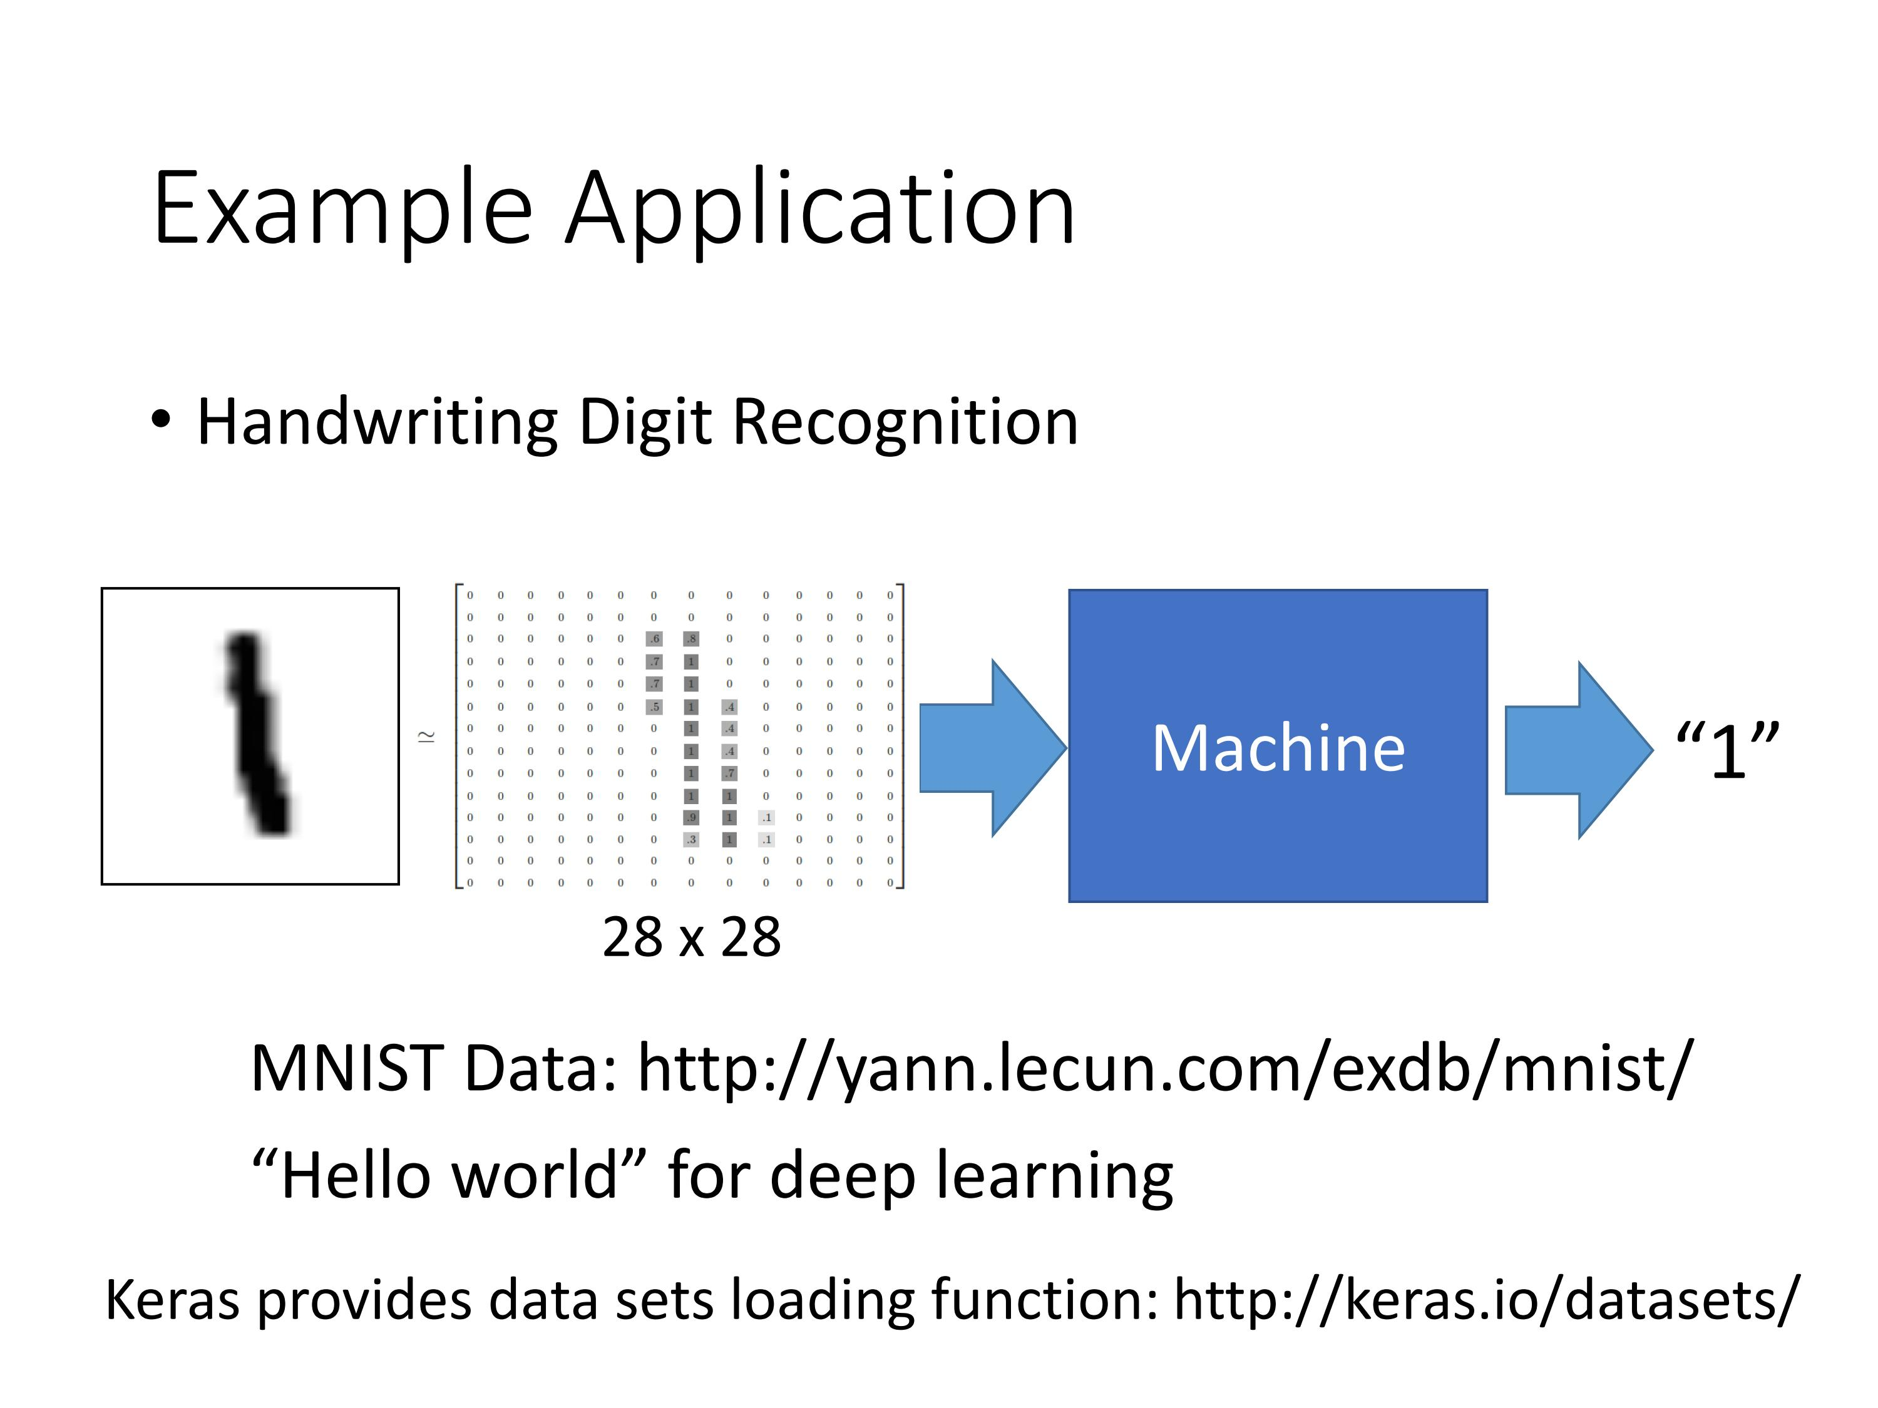

Slide 39
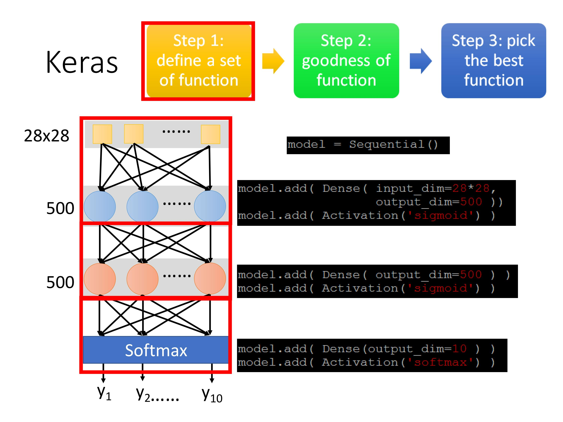

Slide 40
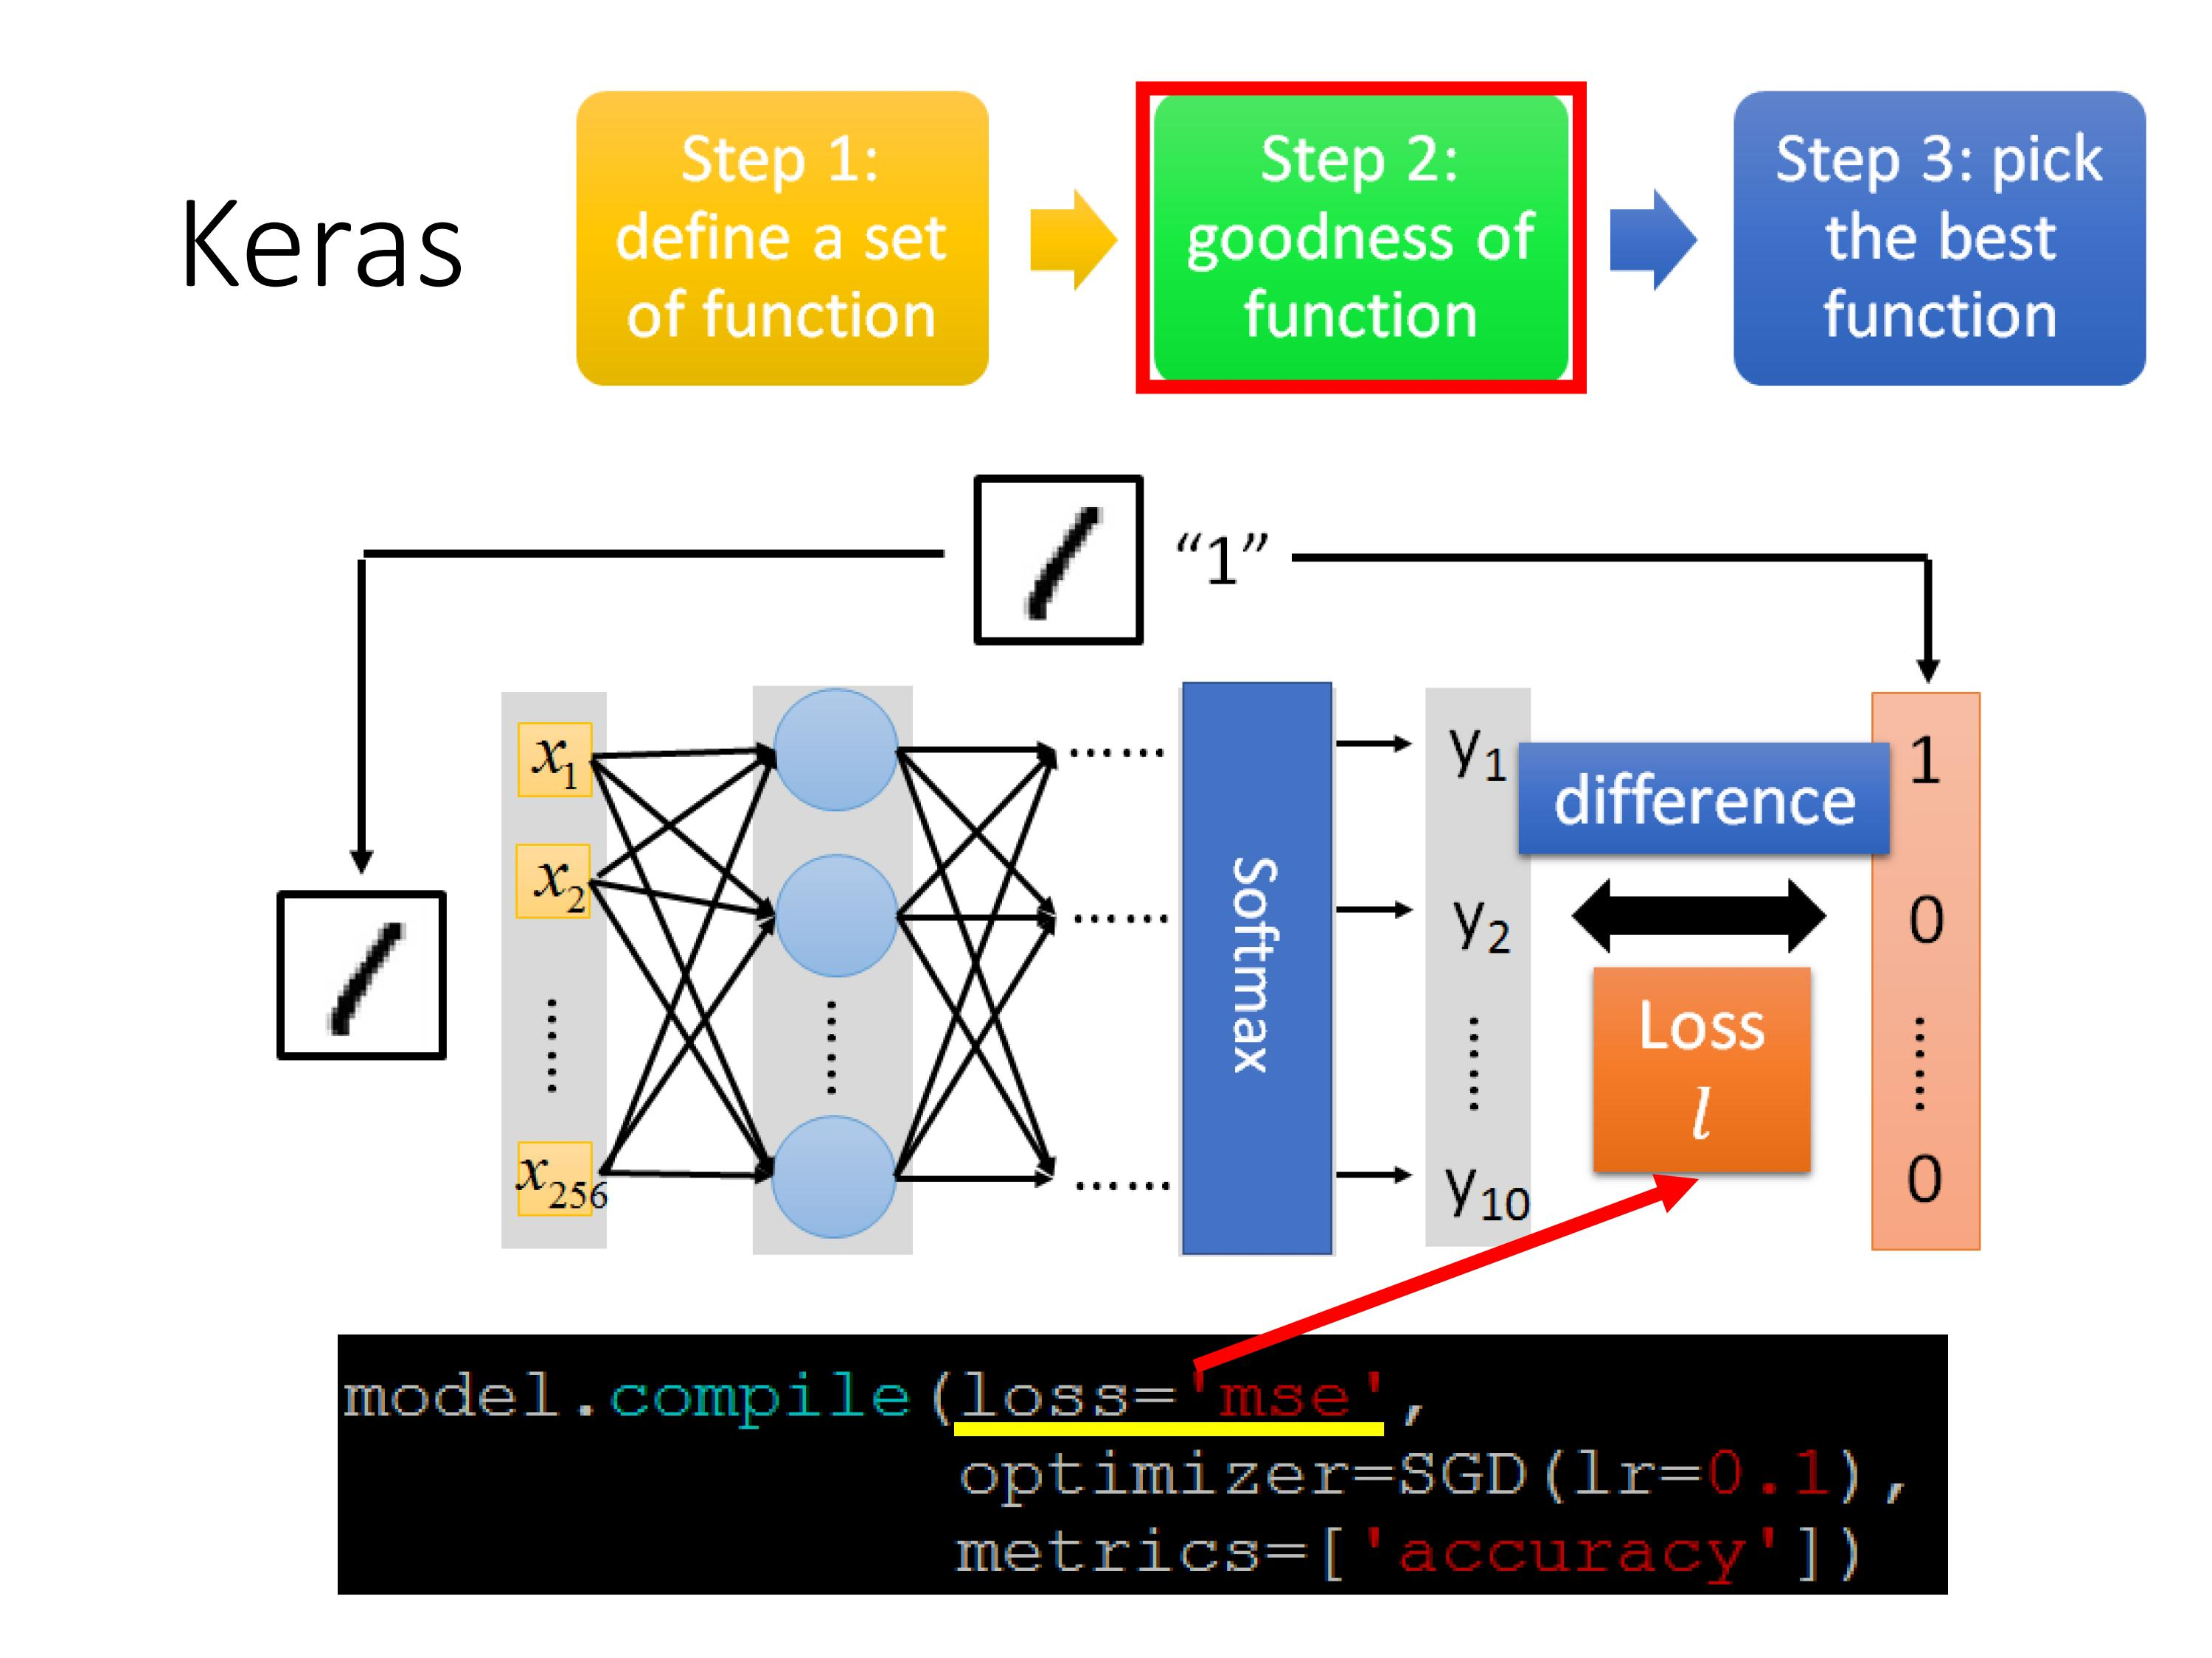

Slide 41
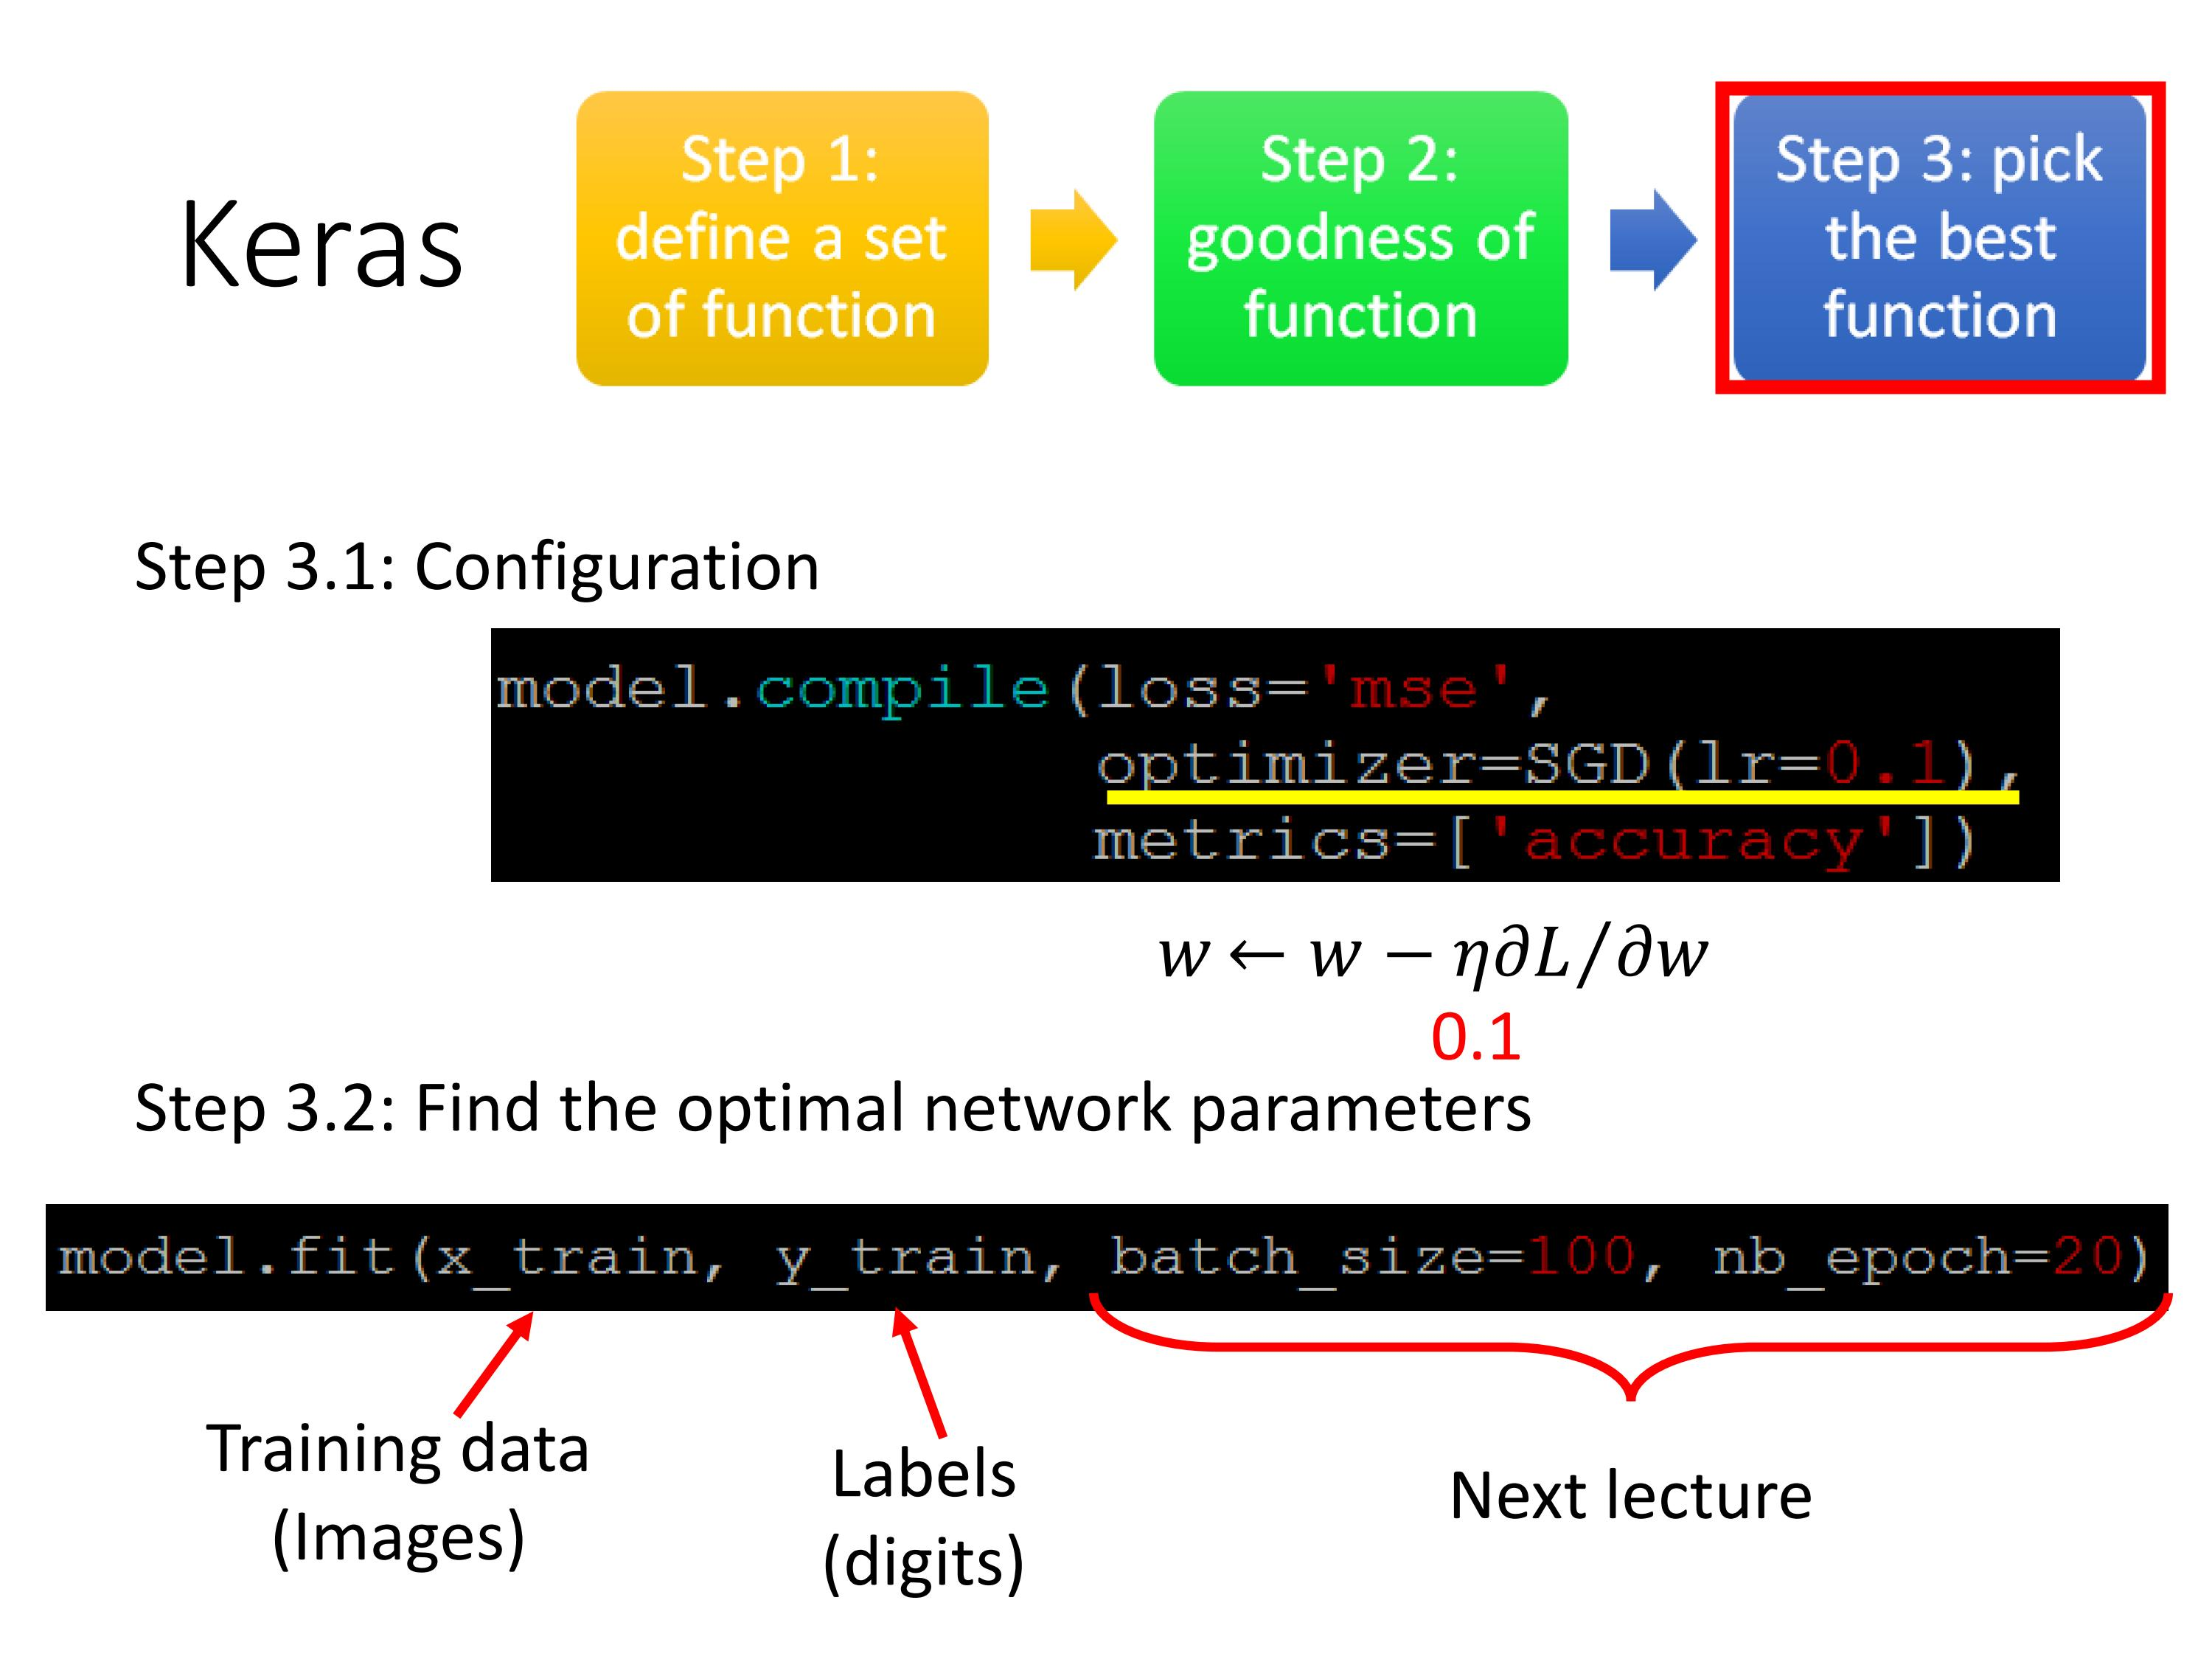

Slide 42
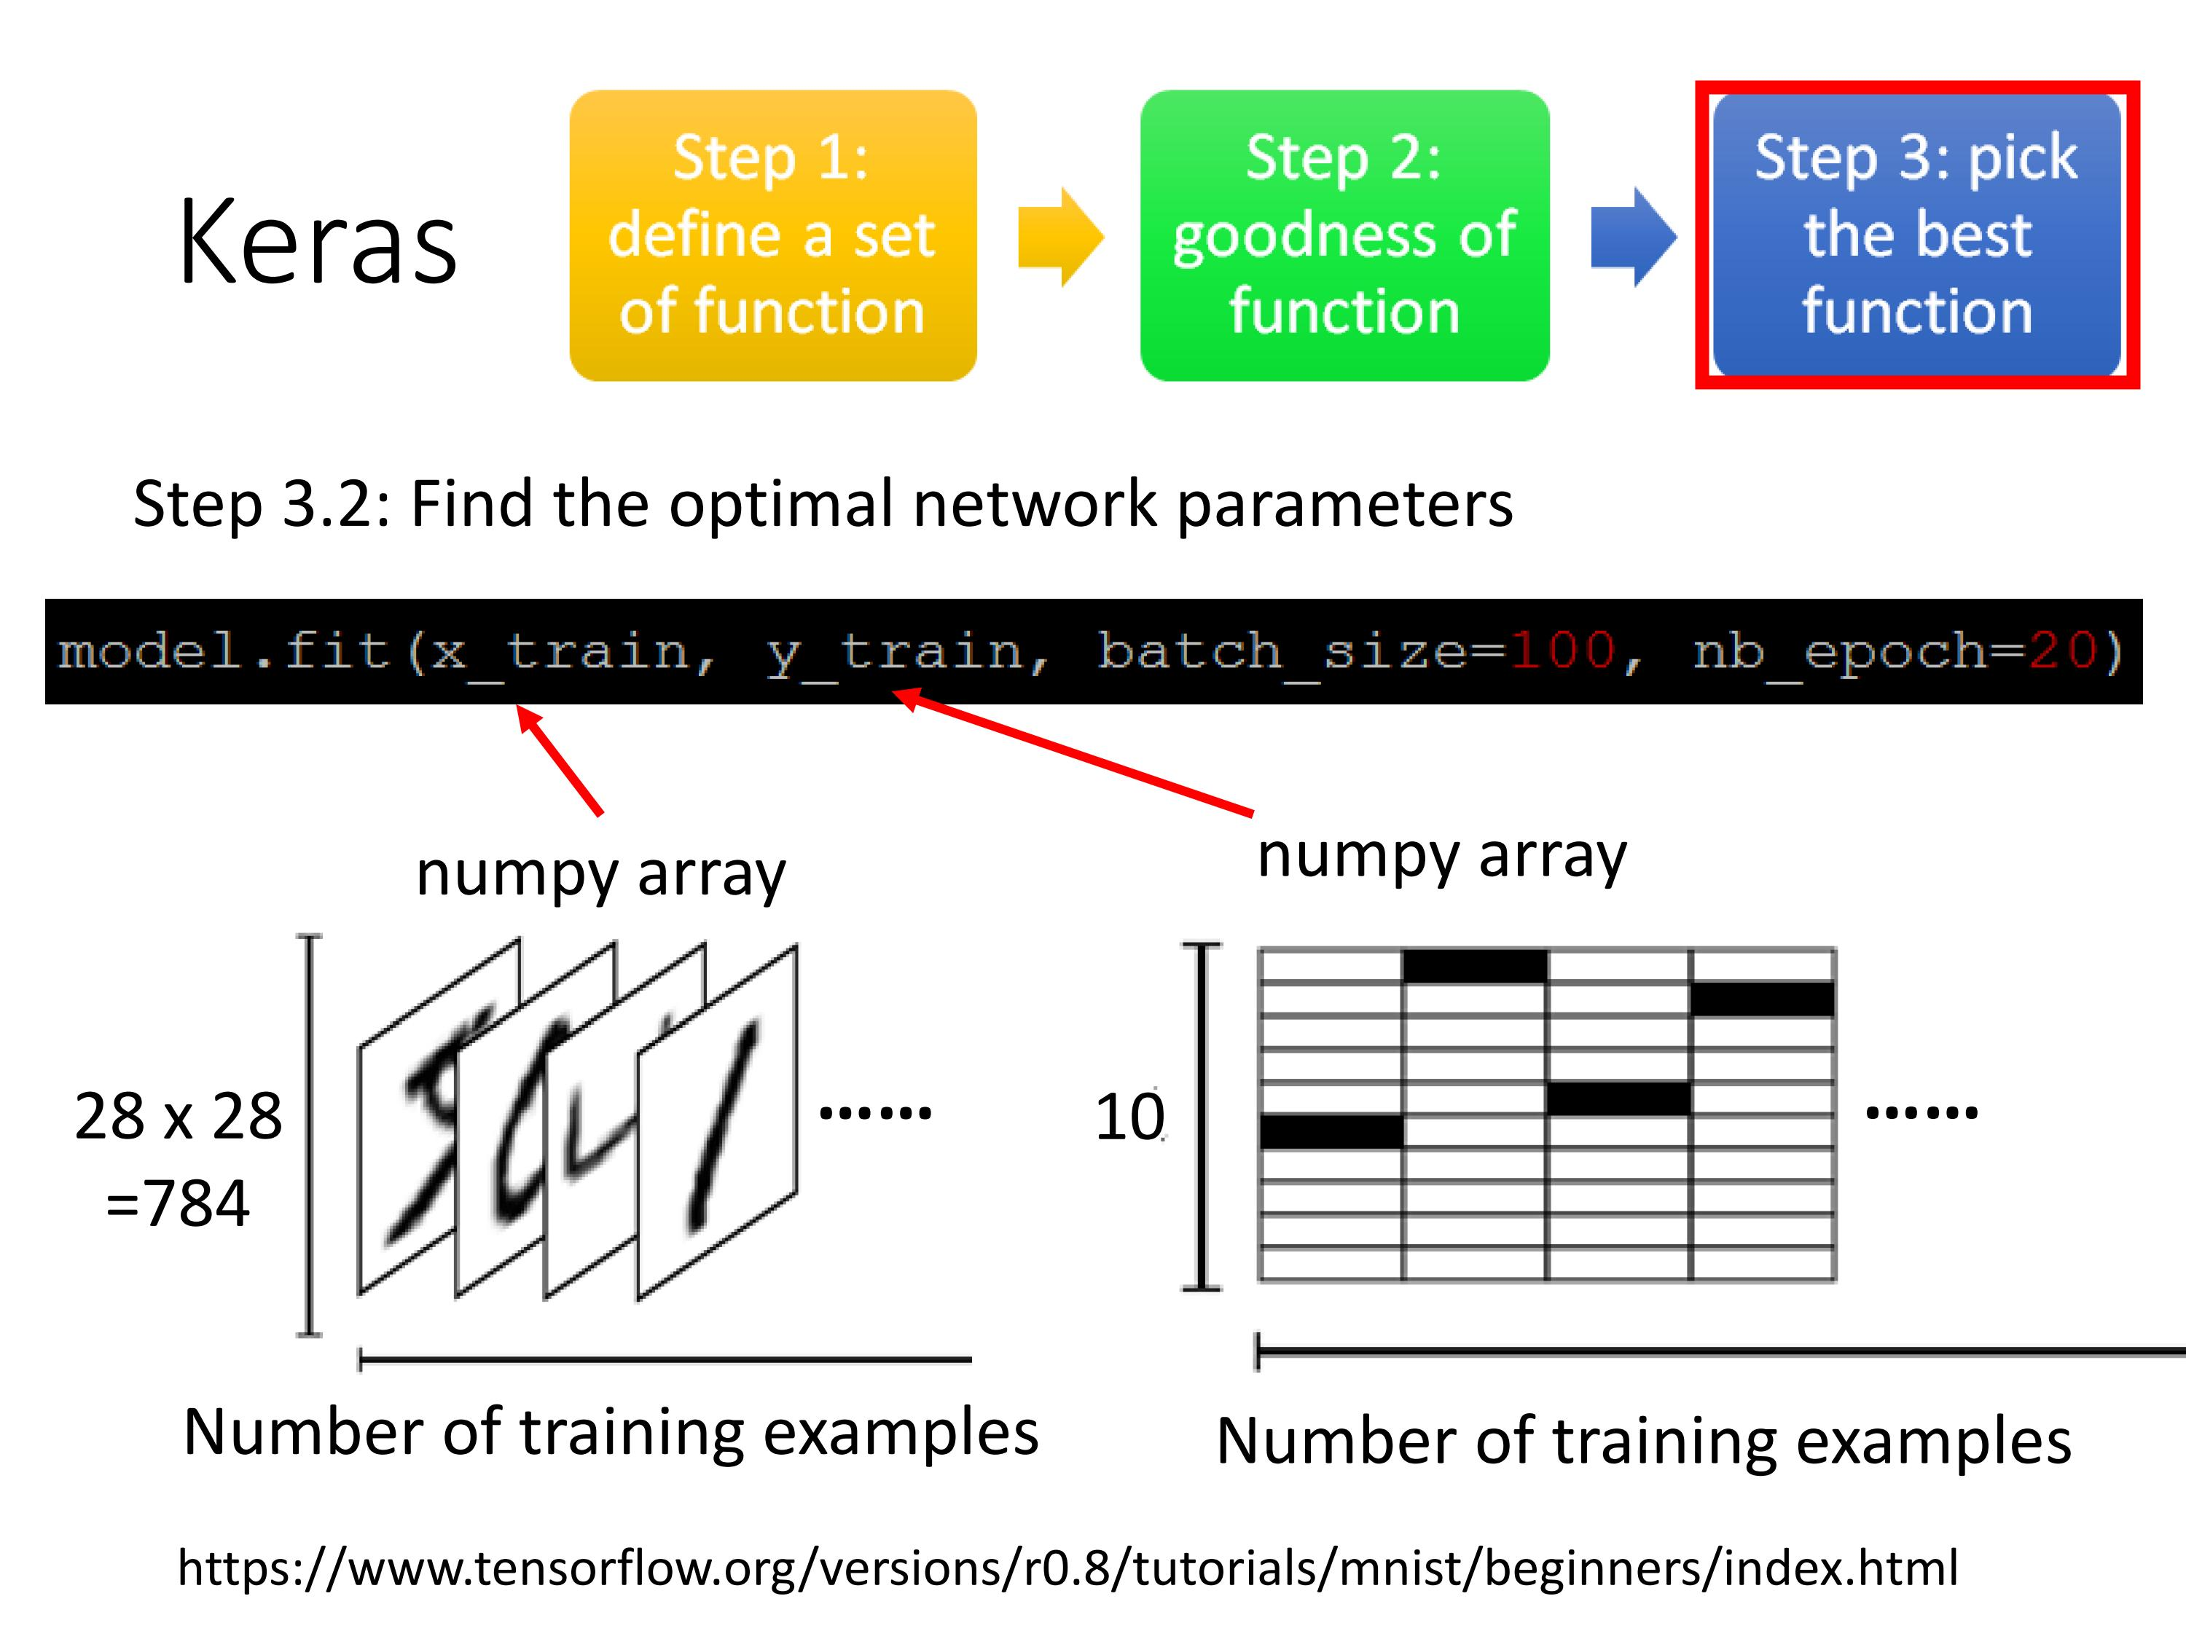

Slide 43
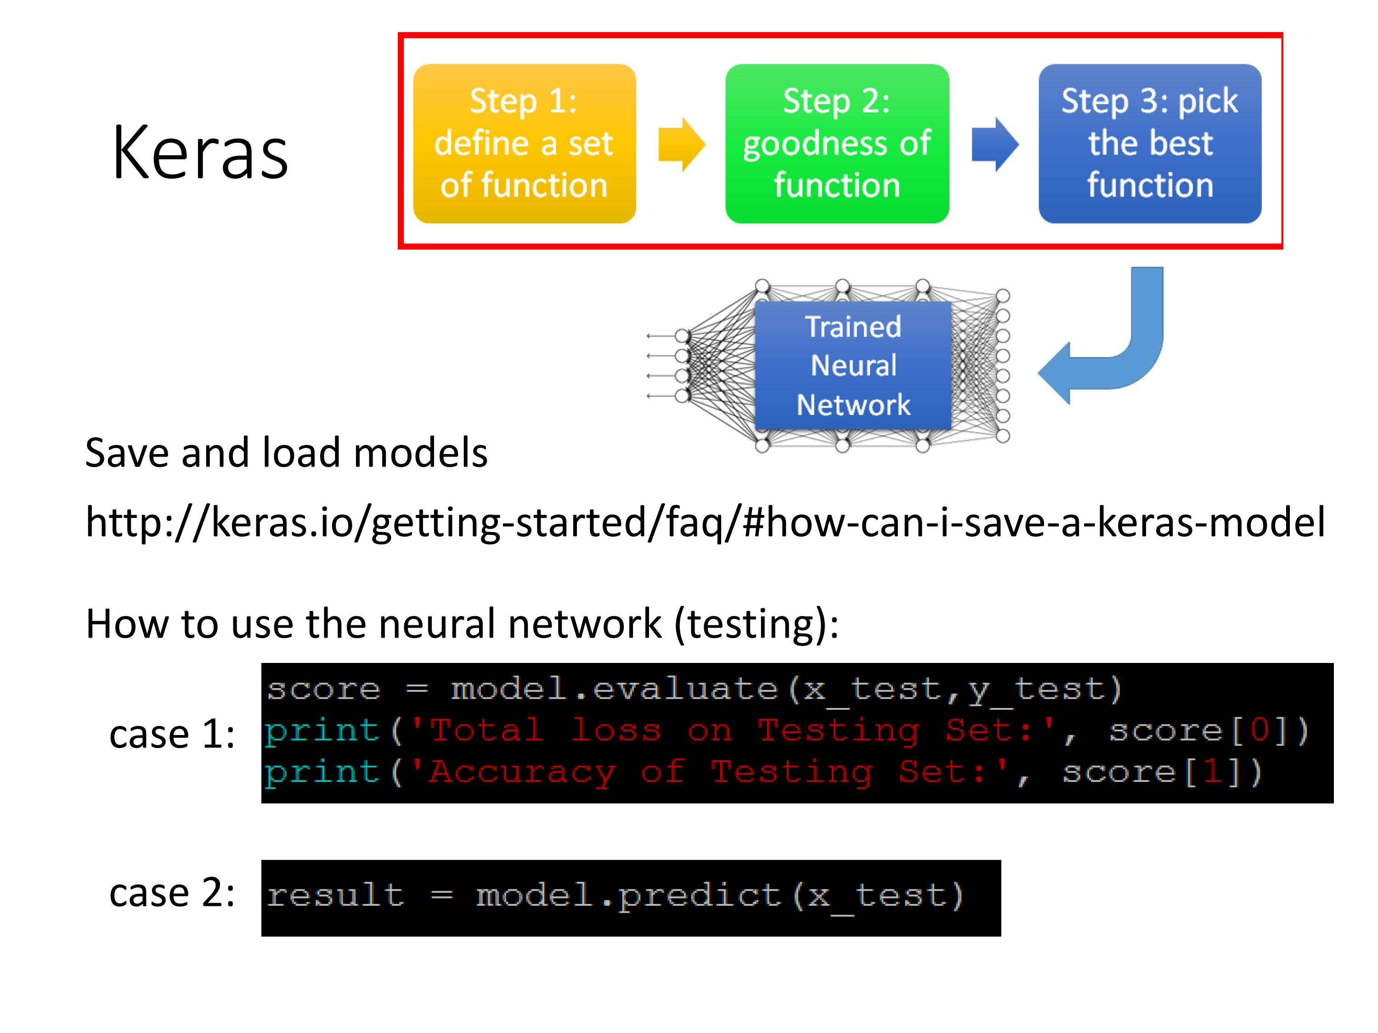

Slide 44
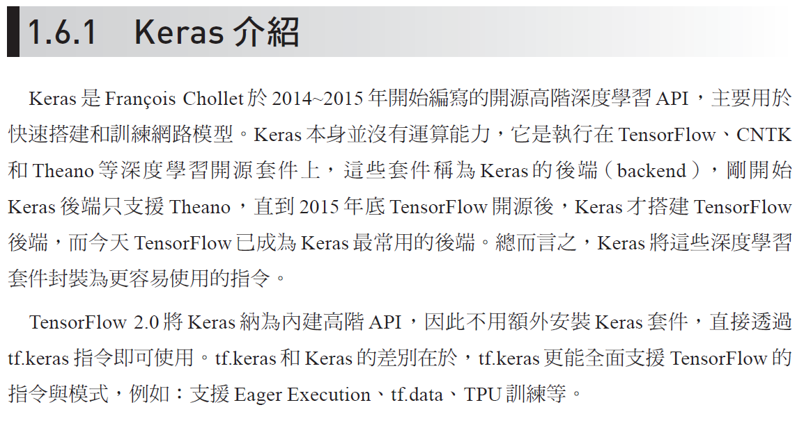
1.6 Keras

Slide 45

1.6 Keras

Slide 46

1.6 Keras

Slide 47

1.6 Keras

Slide 48

1.6 Keras

Slide 49

1.6 Keras

Slide 50

1.6 Keras

Slide 51

1.6 Keras

Slide 52


1.6 Keras

Slide 53


1.6 Keras

Slide 54

1.6 Keras

Slide 55

1.6 Keras

Slide 56

1.6 Keras

Slide 57


1.6 Keras

Slide 58

1.6 Keras

Slide 59

1.6 Keras

Slide 60

1.6 Keras

Slide 61

1.6 Keras

Slide 62

1.6 Keras

Slide 63

1.6 Keras

Slide 64
DonkeyCar Trainning

Slide 65
Create Car
donkey createcar --path <dir> [--overwrite] [--template <donkey2>]
如:
donkey createcar –path ~/mycar

Slide 66
Calibrate Car
donkey calibrate --channel <0-15 channel id>
舵:
donkey calibrate --channel 0
油門:
donkey calibrate --channel 1

Slide 67
Clean data in Tub Opens a web server to delete bad data from a tub.
Hit Ctrl + C to exit
donkey tubclean <folder containing tubs>
例如:
donkey tubclean ~/mycar/data
(Hit Ctrl + C to exit)

Slide 68
Train the model
donkey train --tub=<tub_path> [--config=<config.py>] [--model=<model path>] [--type=(linear|categorical|inferred)]
Uses the data from the --tub datastore
Uses the config file from the --config path (optionally)
Saves the model into --model
Uses the model type --type
Supports filtering of records using a function defined in the variable TRAIN_FILTER in the my_config.py file.

Slide 69
Auto Drive
python manage.py drive --model ~/mycar/models/mypilot.h5
Dataset: [Link] 2GB Data

Slide 70
How to build your own model
https://docs.donkeycar.com/dev_guide/model/

Slide 71
本章結束
Q&A討論時間

